Slide 1
St Louis
April 30th 2010
CNTRICS Workshop
Homology in Neuropsychopharmacology: Relevance for models of schizophrenia
Trevor W. Robbins
Dept. of Expt. Psychology
MRC-Wellcome Trust Behavioural & Clinical Neuroscience Inst.
University of Cambridge U.K.

Slide 2
Homology: the same phylogenetic
(or embryological) origin but not
necessarily the same function
Analogy: connotes resemblance in
function but not structure
(Richard Owen 1802-94)

Slide 3
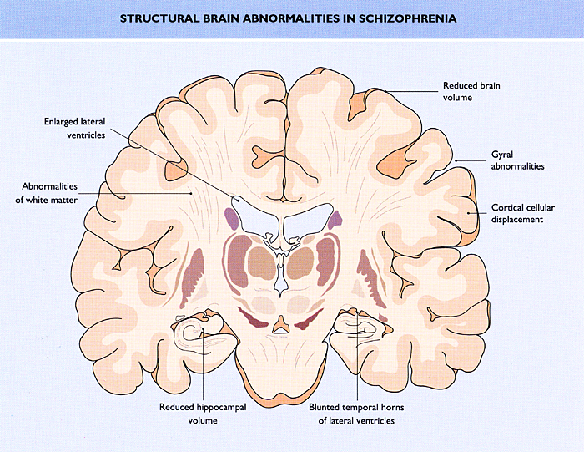
Adding up the signs: diverse neuropathologies
in schizophrenia
Stefan et al
Laruelle et al 1999

Slide 4
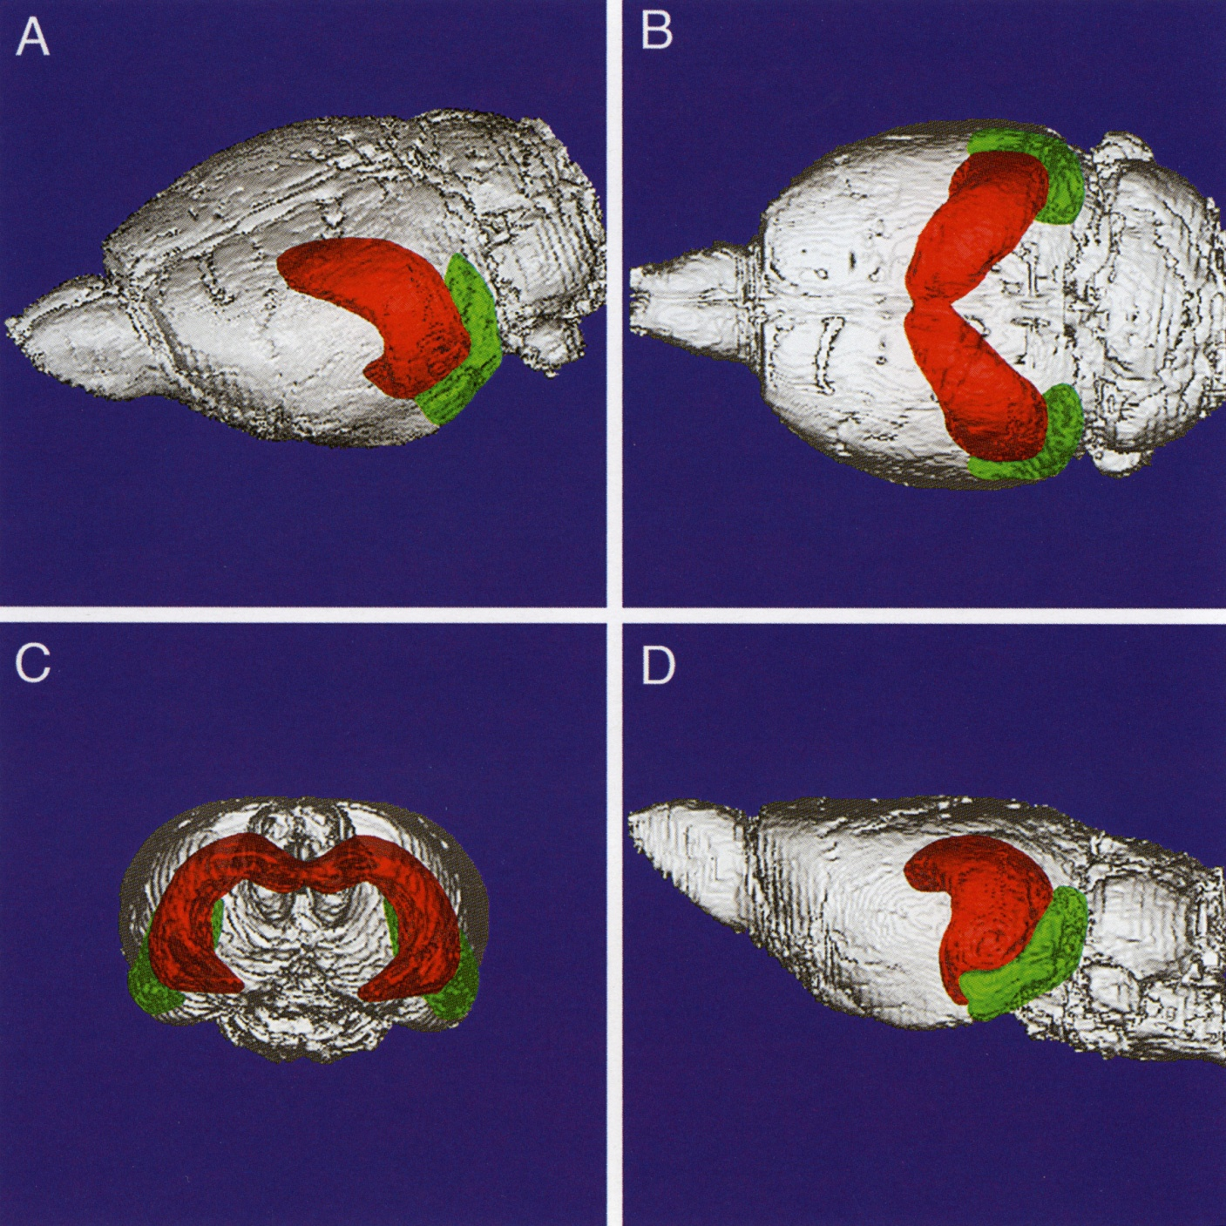
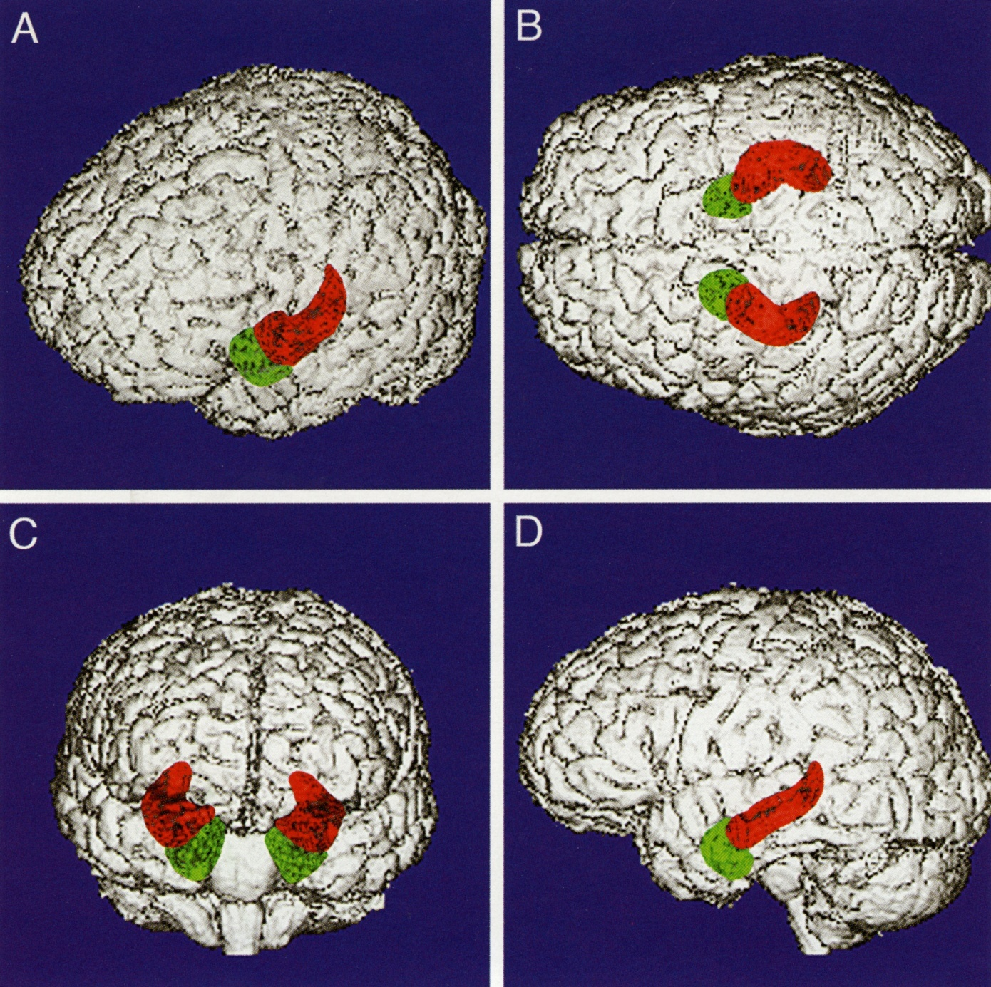
MRI of rat and human hippocampus
Red DG, HC proper, subiculum
Green Entorhinal cortex
G. Allan Johnson. Duke

Slide 5
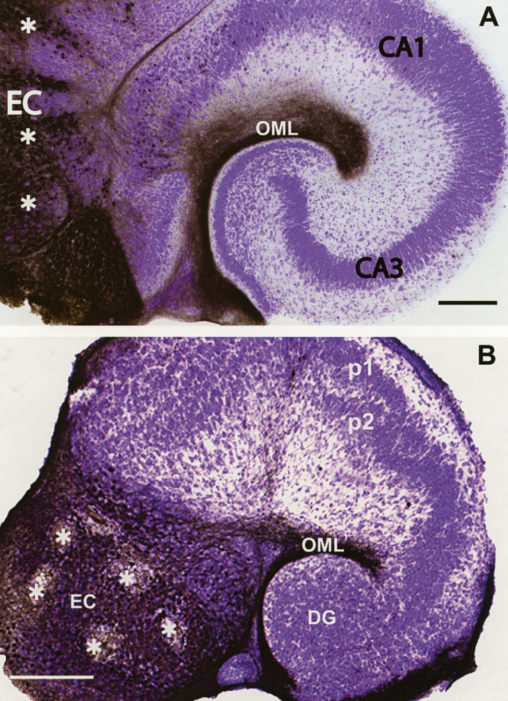
Entorhinal-hippocampal
projection in normal
and reeler mouse
DG
* biocytin injection sites
Zhao et al 2003, sfn

Slide 6
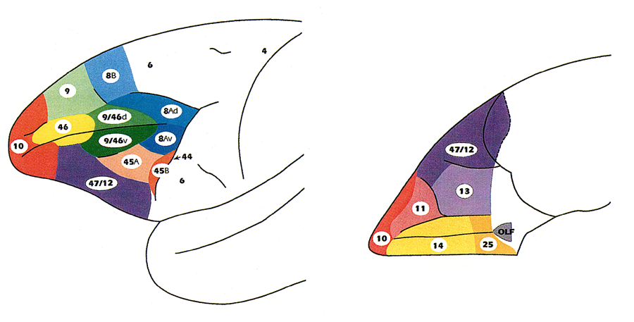
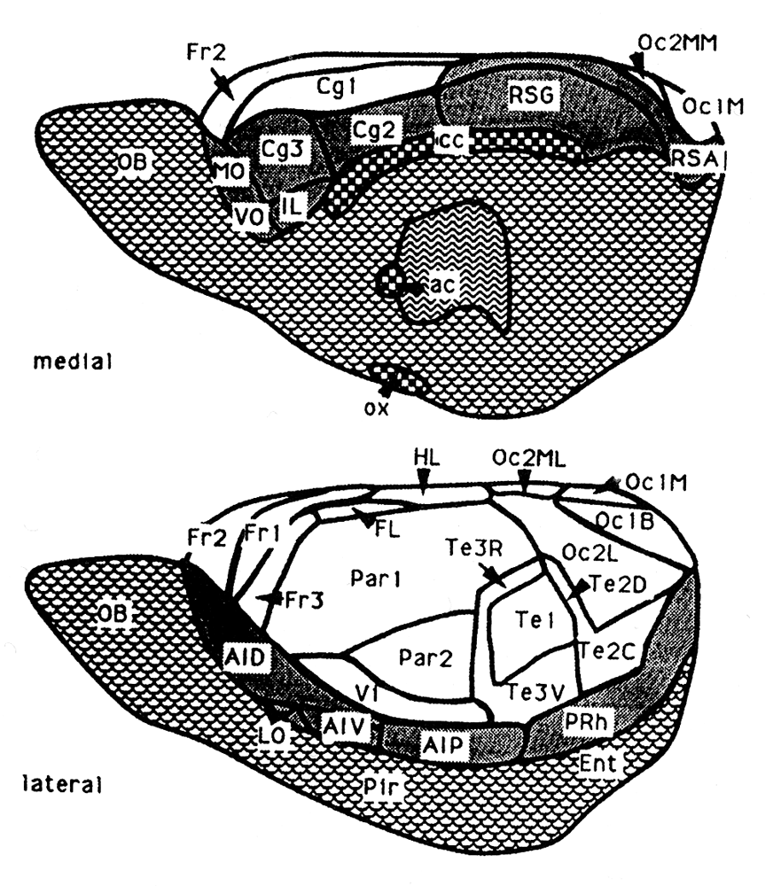
Architectonic maps of human, monkey and rat PFC
Petrides and Pandya
Preuss, T.“Do rats have a PFC?
The Rose-Woolsey-Akert
program revisited”
J. Cog Neurosci. 7, 1-24
But medial PFC and
orbitofrontal cortex
are probably homologous
with similar regions in primate PFC
Zilles

Slide 7
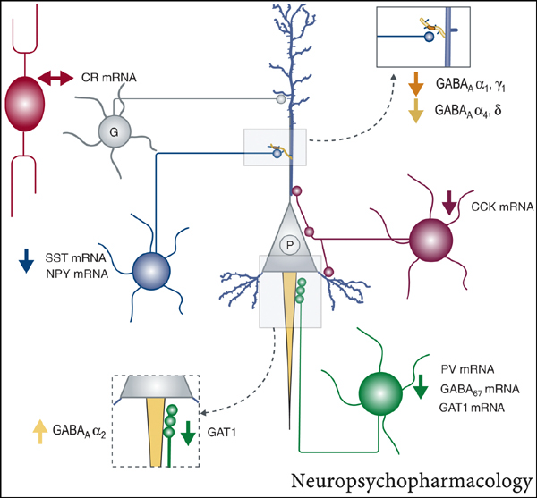
Schematic summary of alterations in GABA-circuitry in dorsolateral PFC in schizophrenia
Lewis & Gonzalez-Burgos 2008

Slide 8
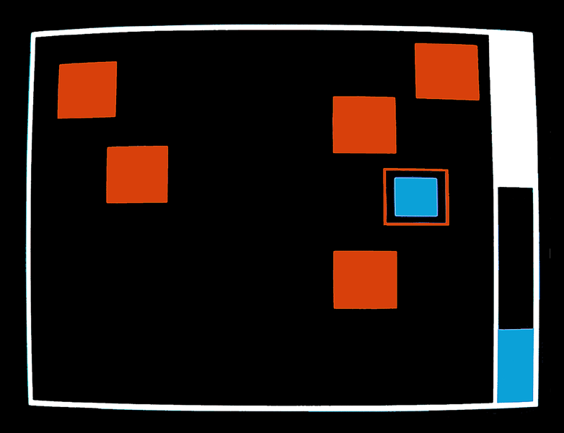
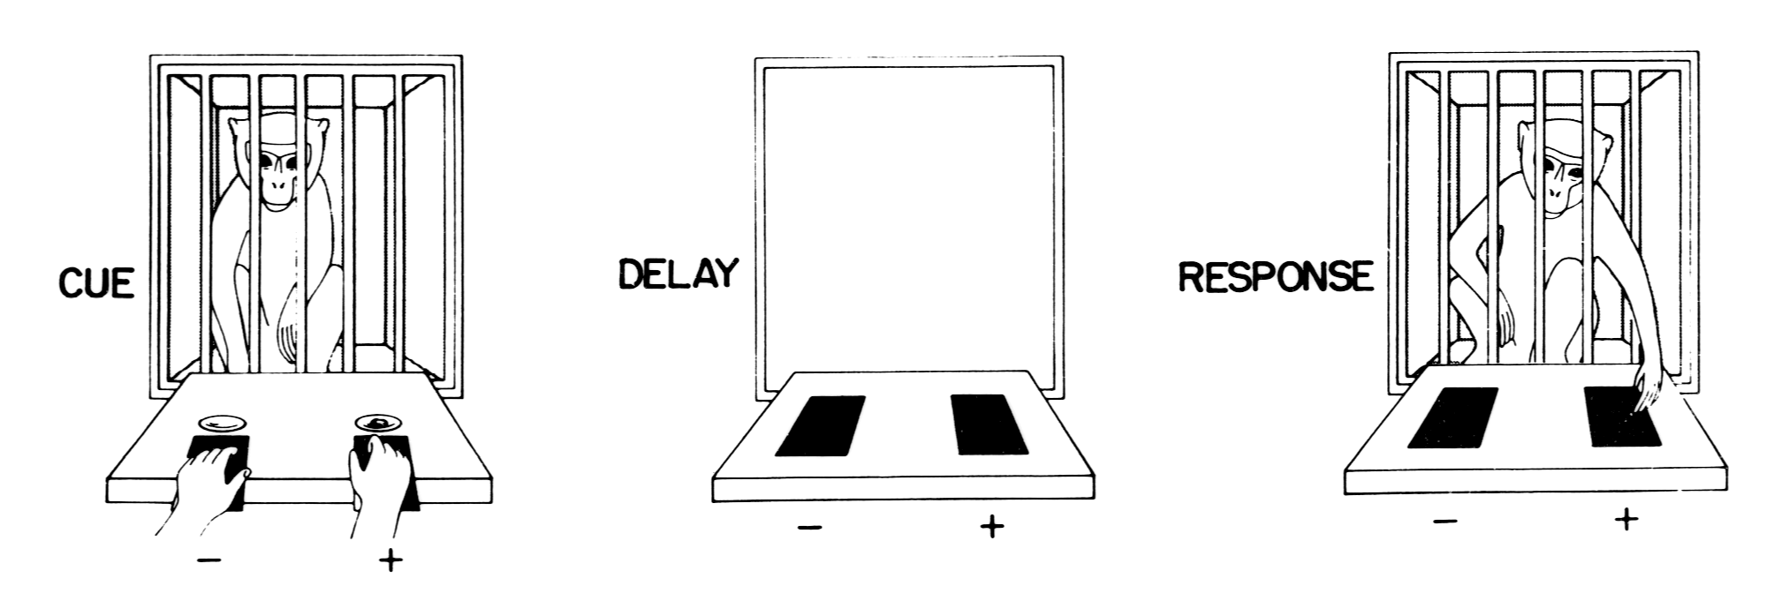
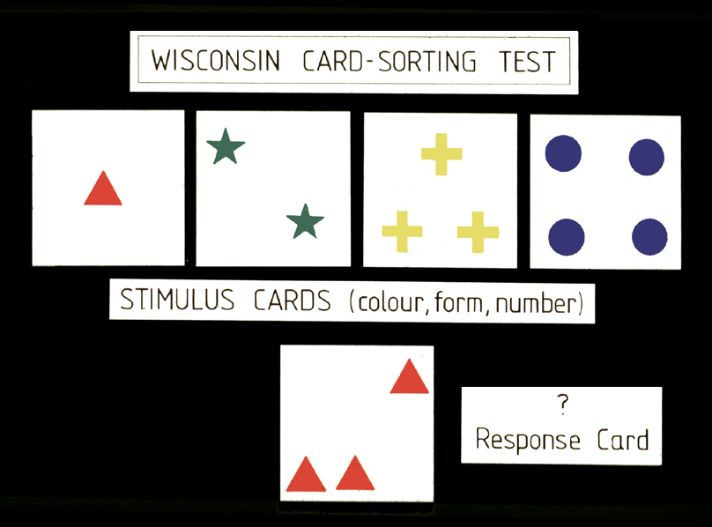
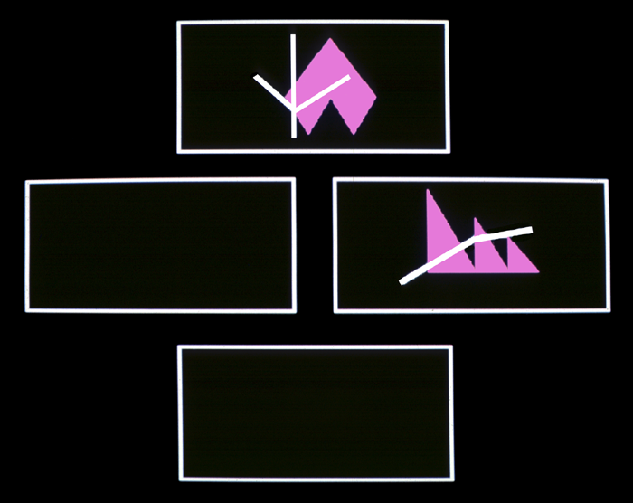
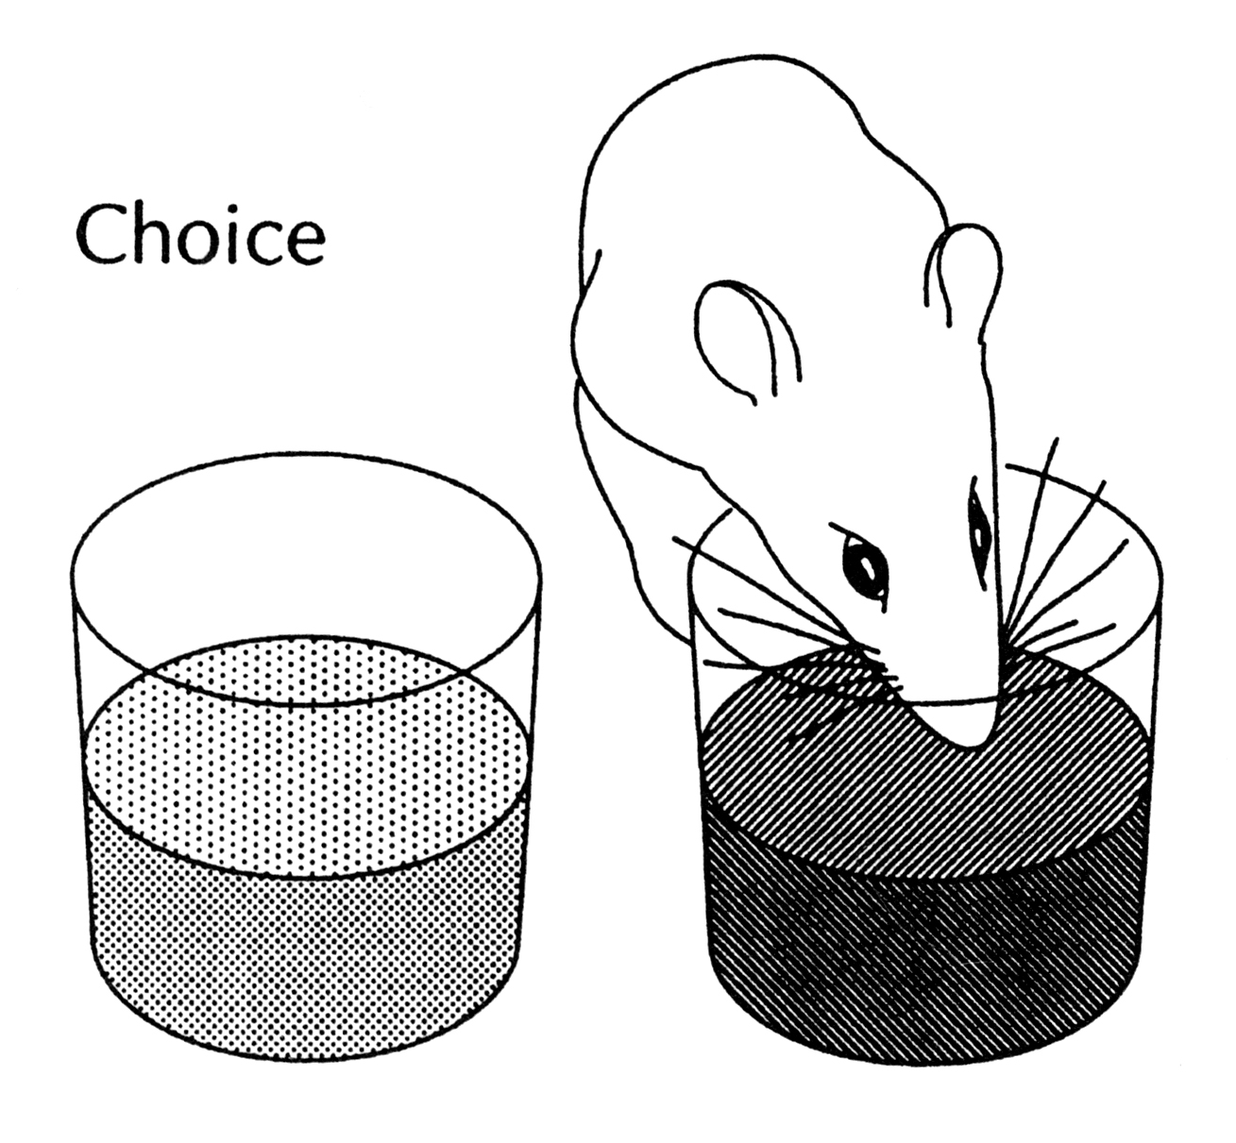
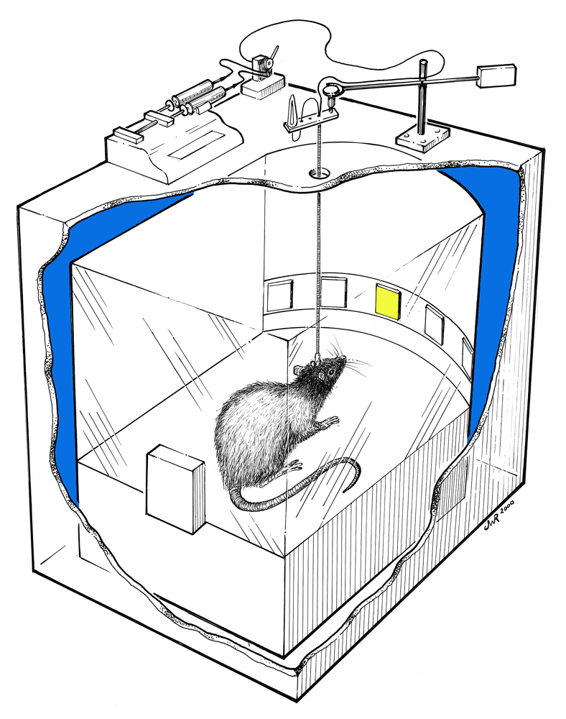
Tests of executive function in monkeys, rodents & humans
BEEP!
>
9
3 5 7
2 4 6
4 6 8

Slide 9
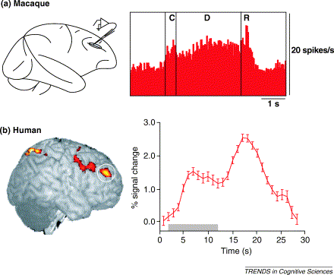
Activity in DLPFC during retention spatial oculomotor task
Curtis & D’Esposito TICS 2003

Slide 10
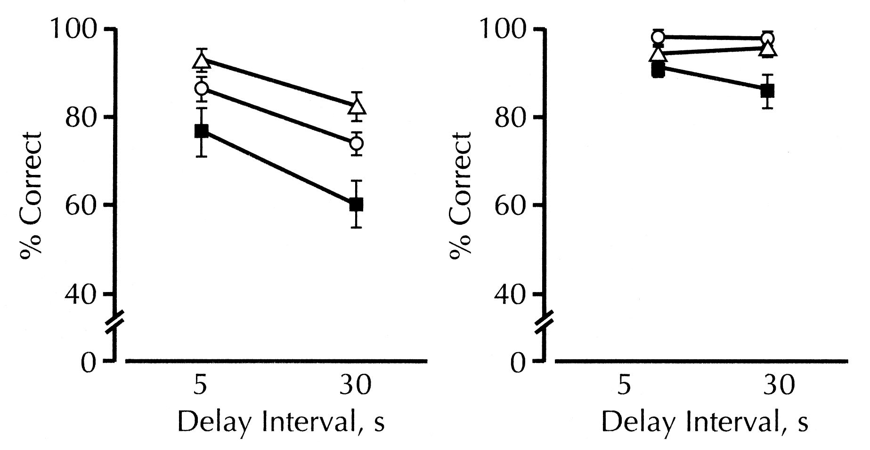
Schizophrenics have impaired working memory
performance on oculomotor DR task
bipolar
schiz
Park & Holzman 1992

Slide 11
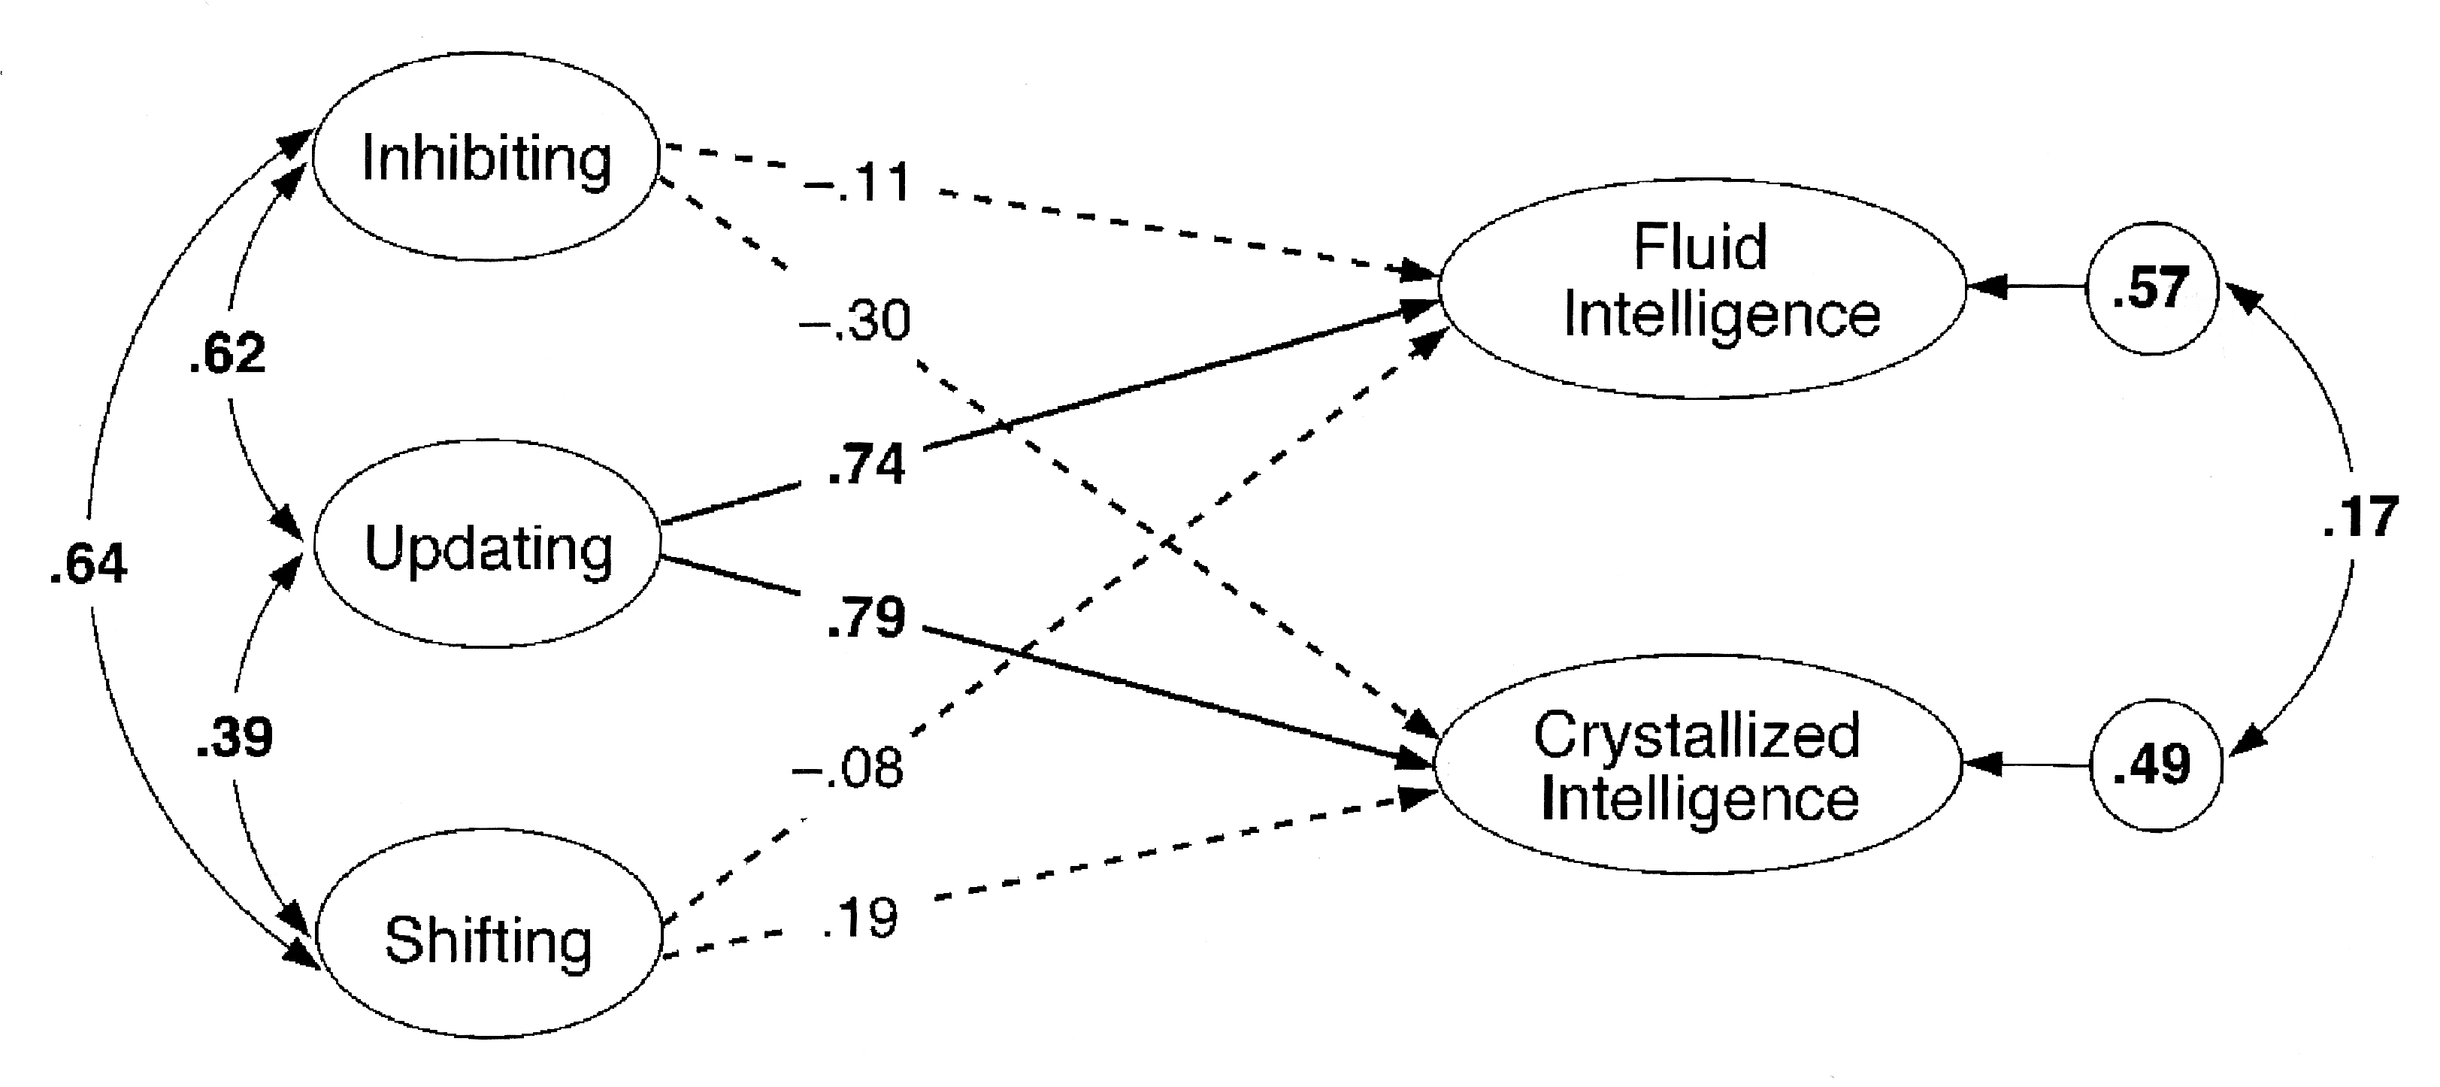
Psychological Science 17, 172-179.

Slide 12
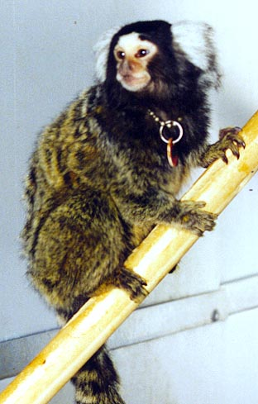
Classical and modern tests of attentional set-shifting
CANTAB ID-ED
Sensitive to frontal lobe damage
in humans (B. Milner)
…. And schizophrenia (D. Weinberger et al)

Slide 13
Three forms of cognitive flexibility/plasticity
shape to line
line to shape
basic discrimination task
shape to shape
line to line
stimuli stay the same;
reward shifts

Slide 14
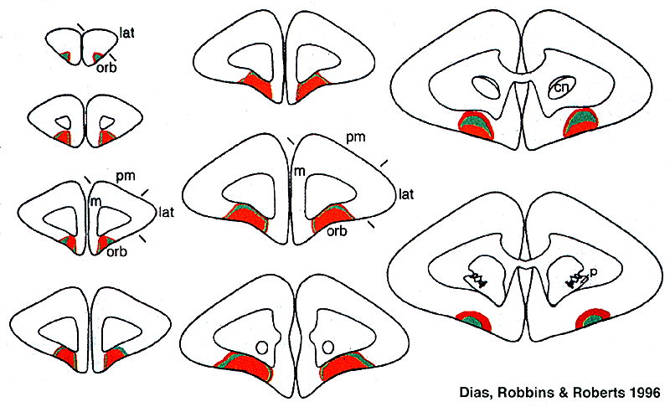
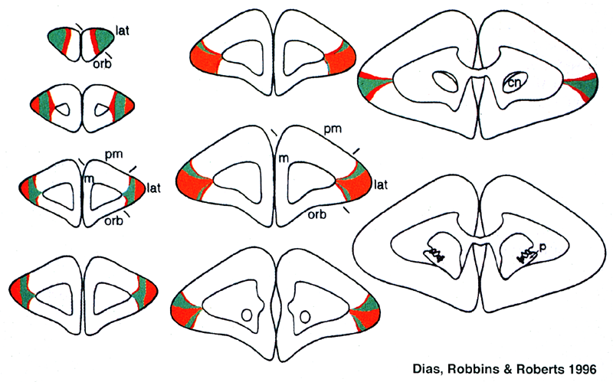
Double dissociation of EDS and reversal learning after frontal lesions
orbitofrontal
lateral
Dias , Robbins & Roberts Nature 1996

Slide 15
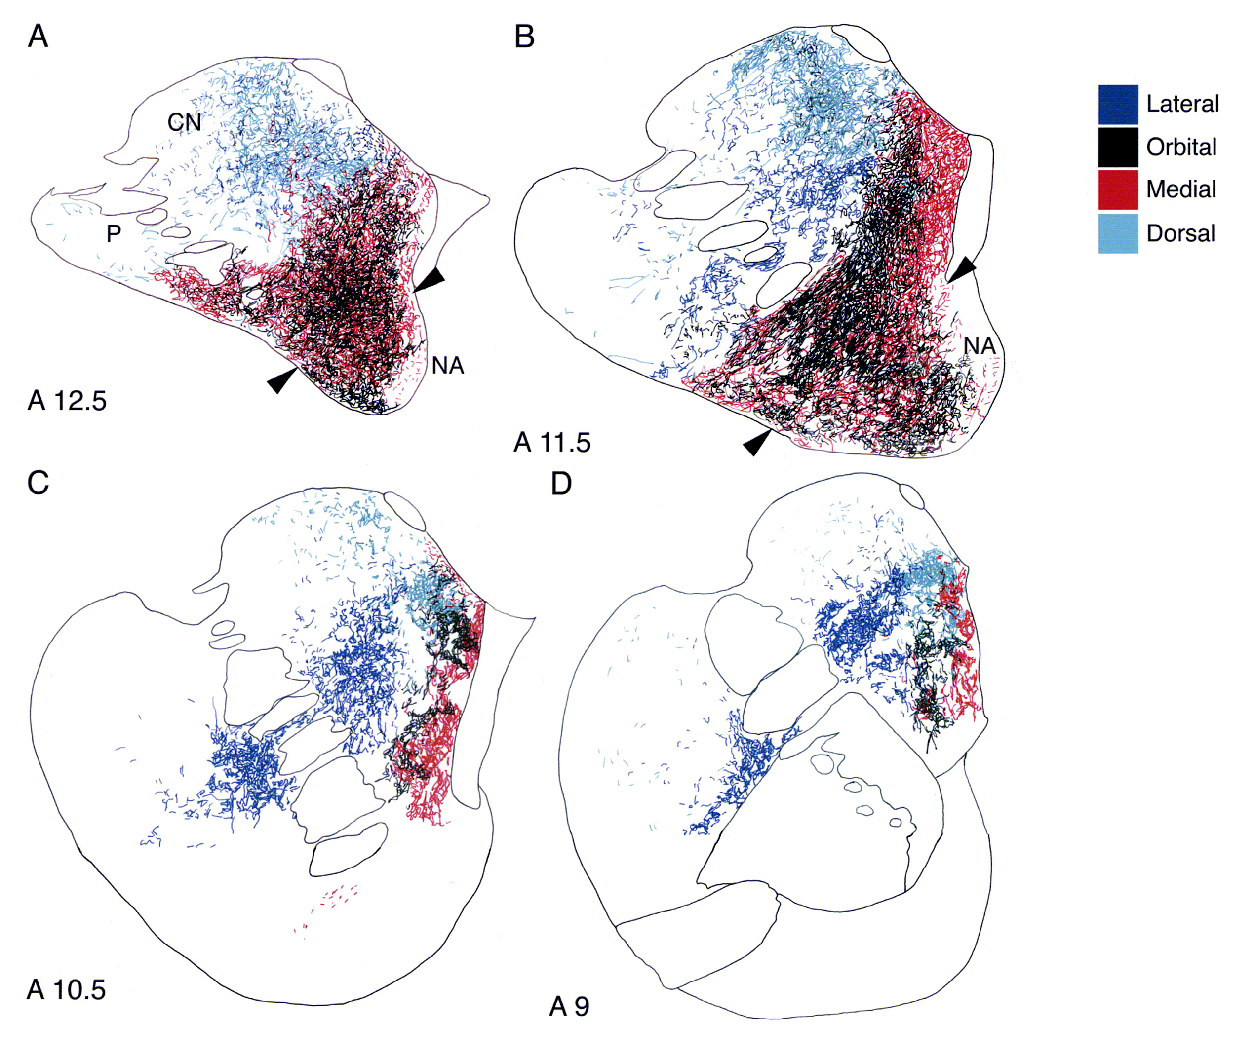
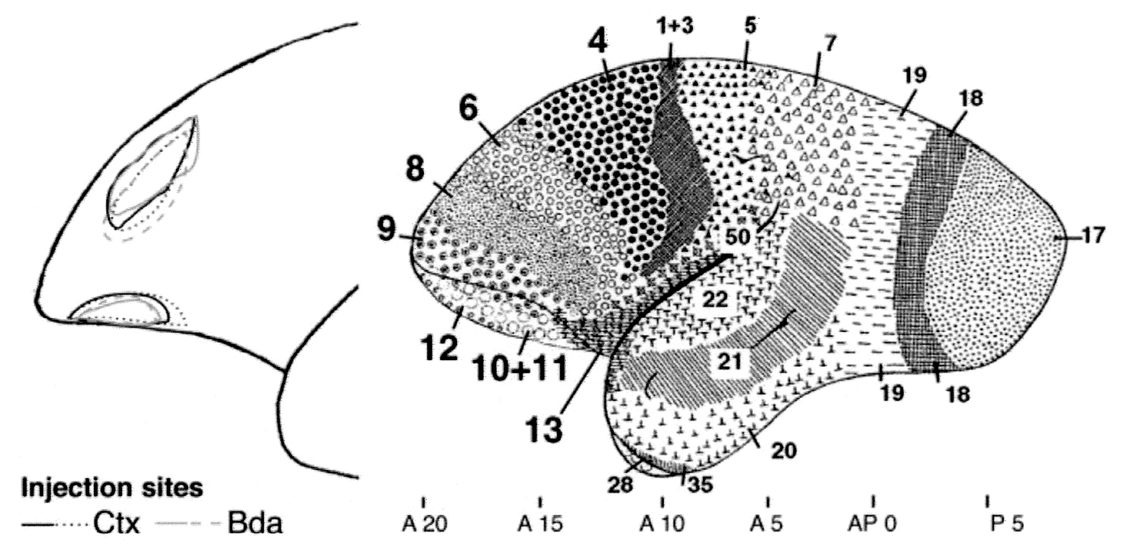
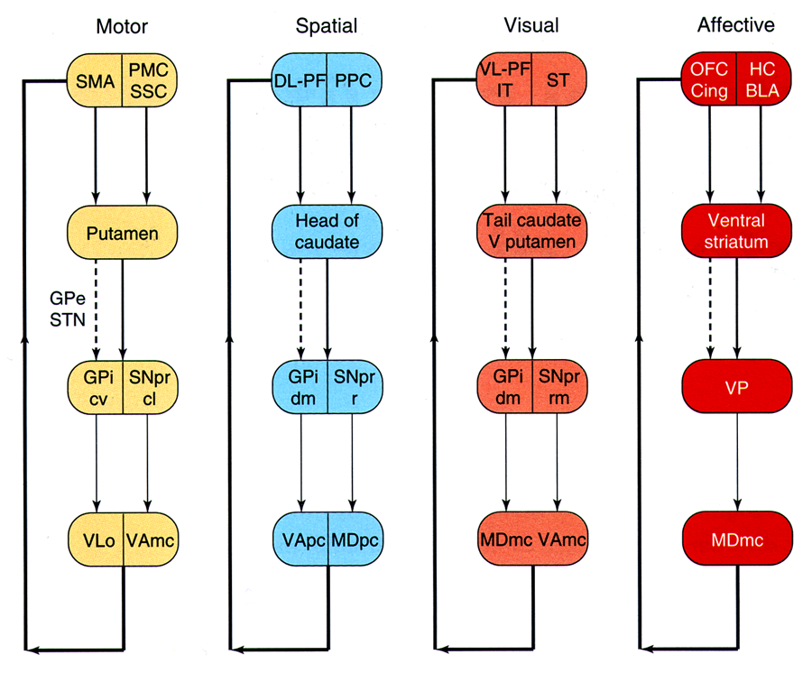
Mapping the cortico-striatal loops in the marmoset brain
Roberts et al
J Comp. Neurol.
2007

Slide 16
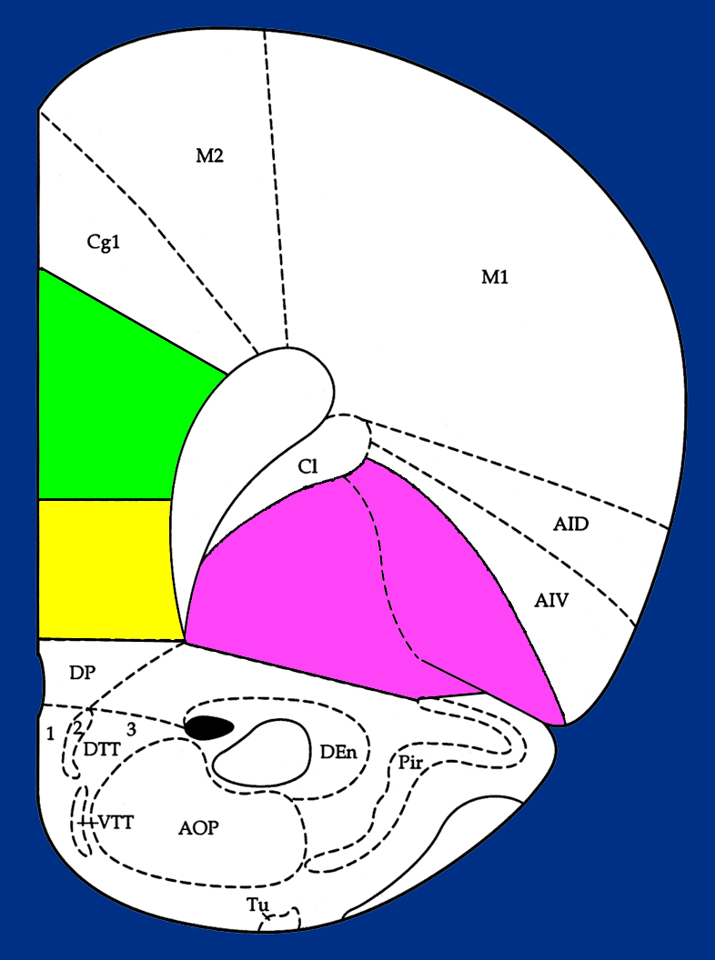
Double dissociation of reversal learning and
extra-dimensional set-shifting in rats
Cg3
IL
VO
LO
; Birrell and Brown 2000;Brown & Bowman 2002 ; McAlonan & Brown 2003

Slide 17
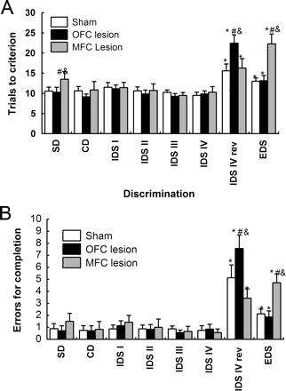
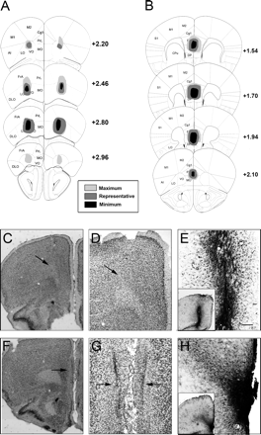
Double dissociation of effects of PFC lesions performance
on reversal and set-shifting tasks in mice
Bissonette, G. B. et al. J. Neurosci. 2008;28:11124-11130
Copyright ©2008 Society for Neuroscience

Slide 18
Over-expression of human COMT-Val impairs attention shift task in mice
a
Papeleo et al Journal Neuroscience 2008
80
*
#
60
Trials to criterion
40
20
0
SD
CD
CDR
IDS
IDSRe
IDS2
IDSRe2
EDS
EDSRe
b
*
120
*p<.01 v. controls
#p<.0005 v. other stages
#
90
Minutes
60
30
0
SD
CD
CDRe
IDS
IDSRe
IDS2
IDSRe2
EDS
EDSRe

Slide 19
fMRI of WCST analogue in humans and macaque
Shift activations
In ventrolateral PFC
B.A. 44/45
Inferior frontal
sulcus
Nakahara et al 2002

Slide 20
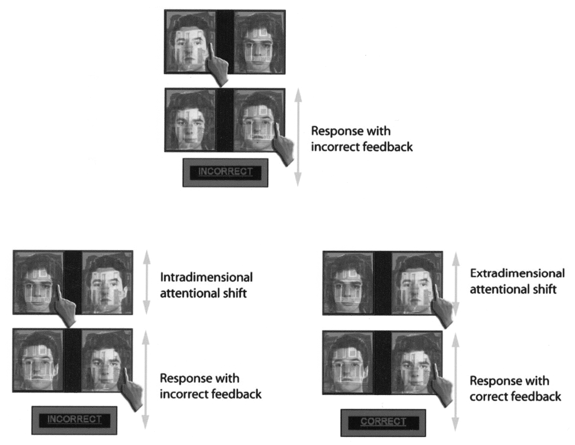
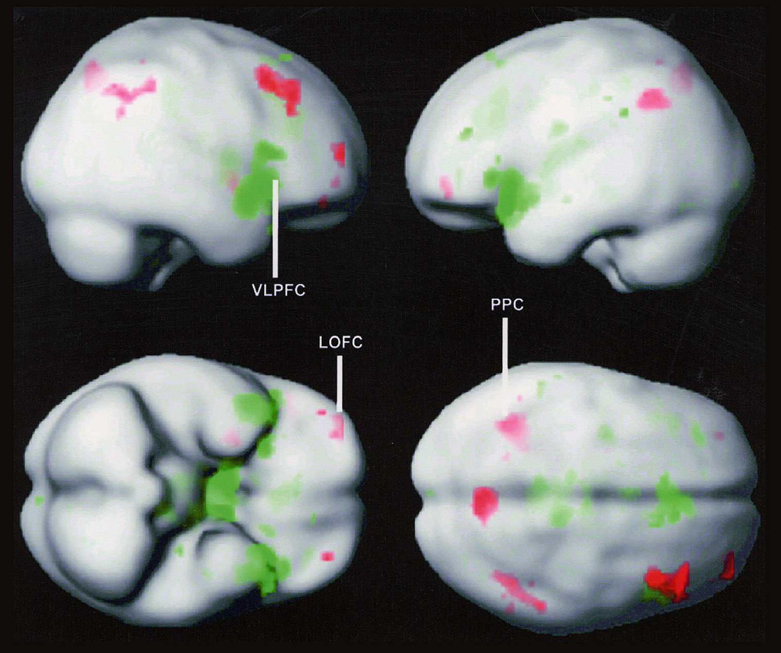
Extra-dimensional set shifting and reversal learning
involve different PFC circuitry: Evidence from human fMRI
Reversal =OFC
EDS=VL-PFC
Hampshire & Owen Cerebral Cortex, 2006

Slide 21
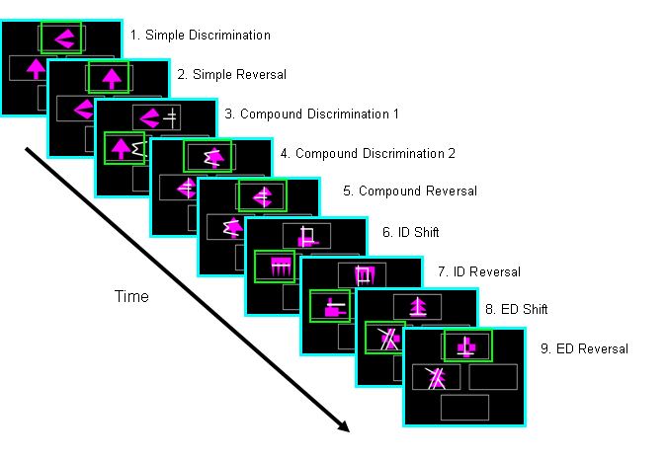
CANTAB: Attentional set-shifting (and reversal)

Slide 22
Chronic Schizophrenics
perform at least as badly
as frontal (and much worse than temporal or hippocampal) patients on the attentional set-forming and shifting tasks
Percentage passing each stage
Nb unusual difficulty
Of schizophrenics
with the ID
(as well as ED)
shift stage
Pantelis et al, Schiz. Res 1999

Slide 23
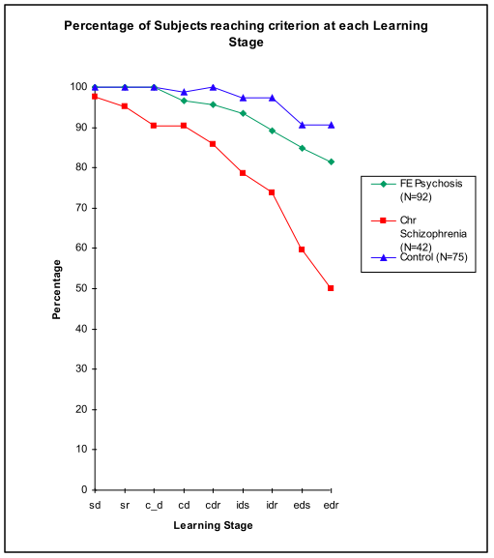
Attentional set-formation and shifting in schizophrenia
ID/ED set-shifting unimpaired in FE Sz but very poor in chronic Sz (Pantelis et al, 1999; Hutton et al, 1998; Elliott et al, 1995)
suggesting change over illness in frontal brain regions

Slide 24
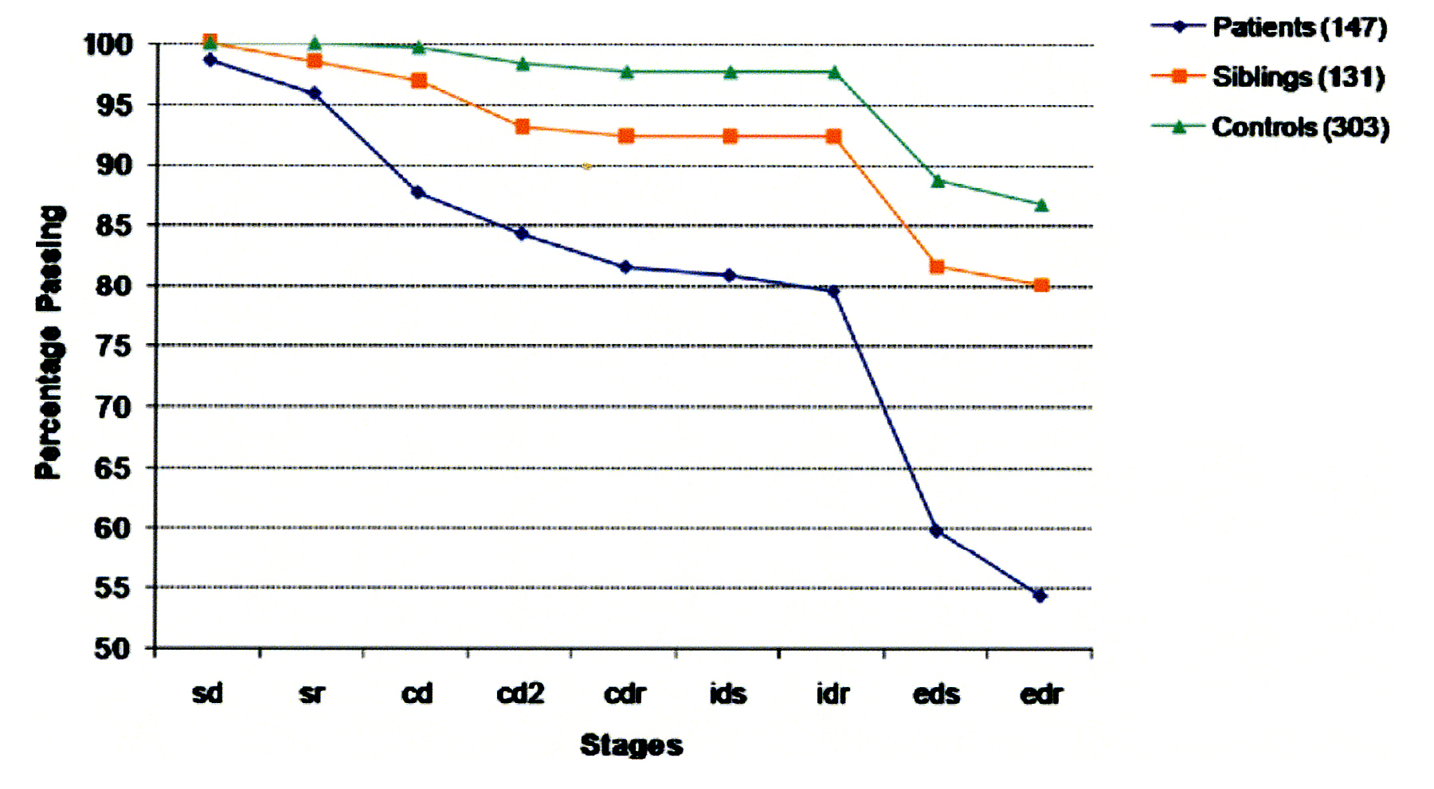
ED-shifting is not an endophenotype in schizophrenia
Ceaser et al 2008

Slide 25
Improvement in IDED following modafinil in schizophrenia
SCHIZ.
Improvement →
Stages →
Turner et al 2004

Slide 26
Back-translation: Modafinil improves eds performance
in rats following chronic PCP
Goedthegebeur & Dias Psychopharmacology (2009)

Slide 27
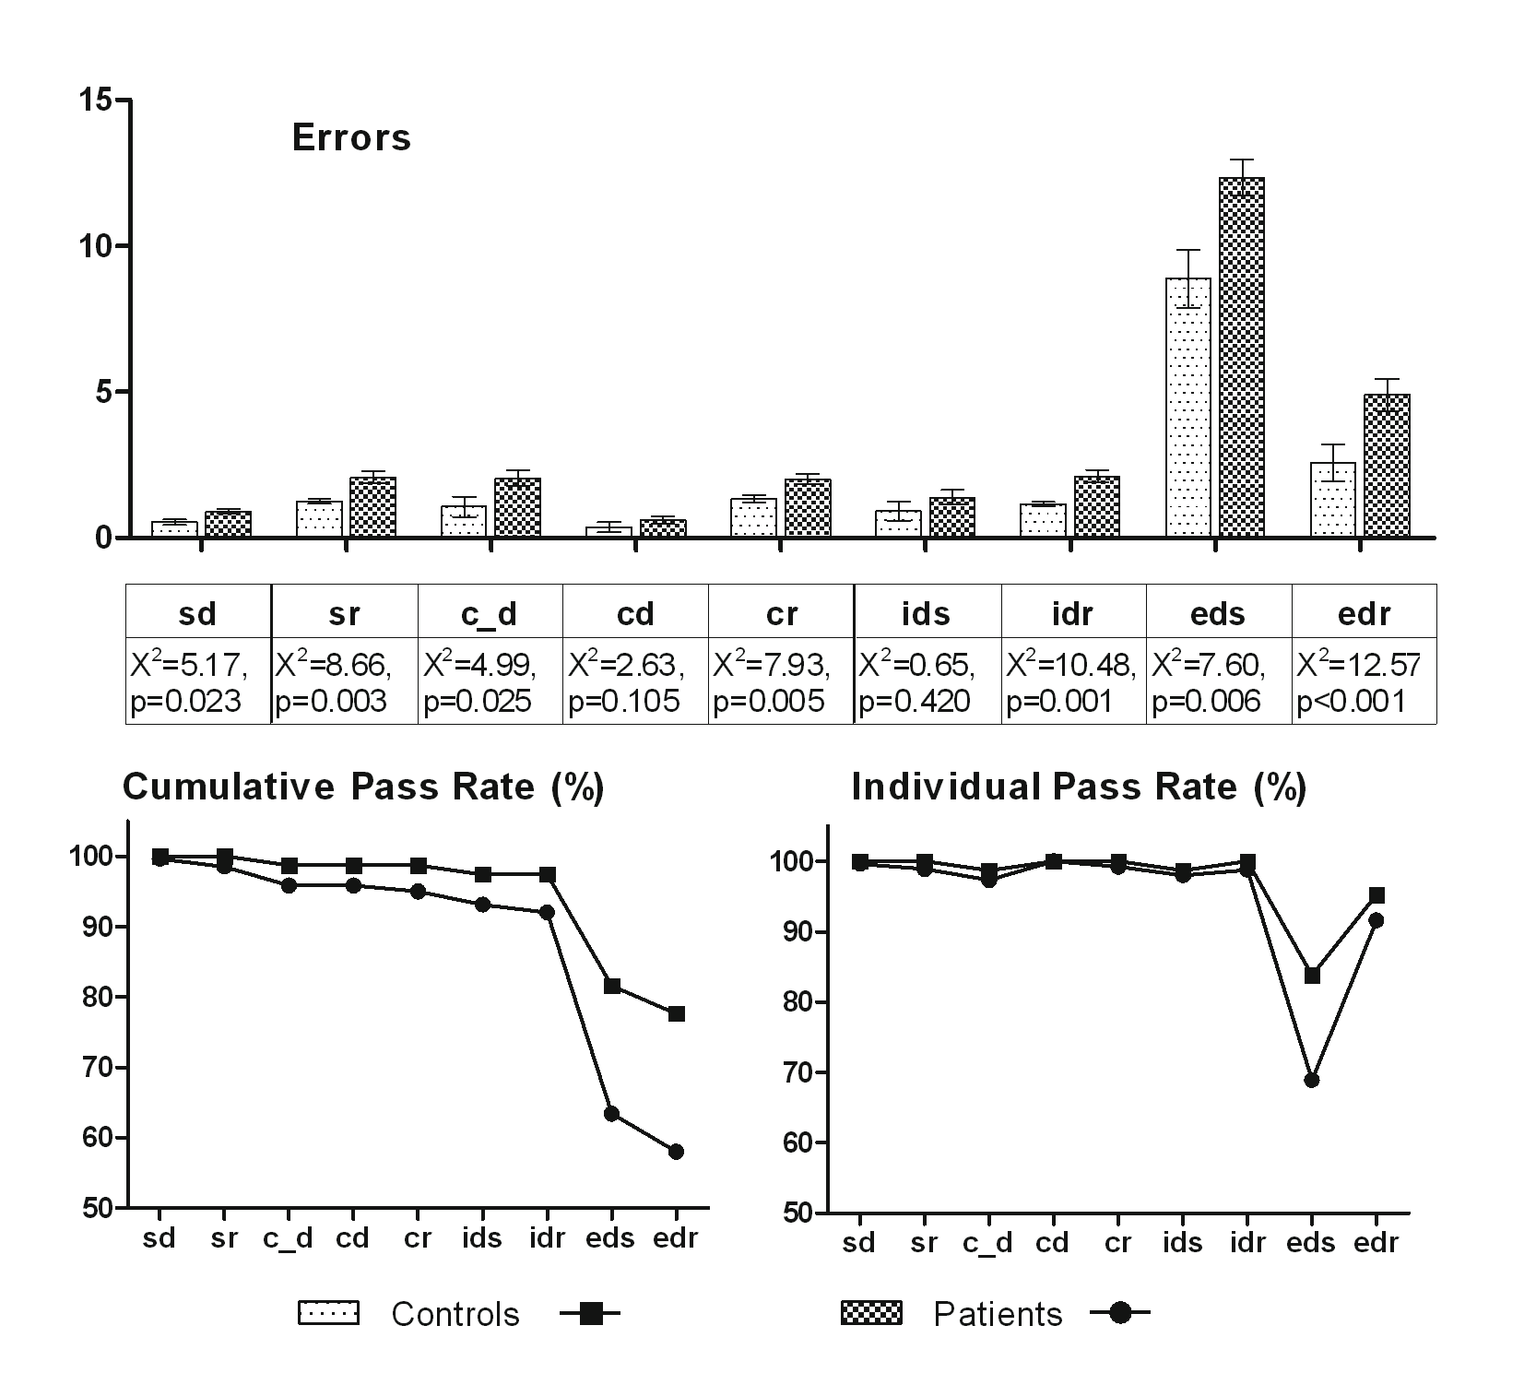
Detailed error analysis in first episode schizophrenia
reveals consistent deficits on reversal
Leeson et al 2009 Biol. Psychiat

Slide 28
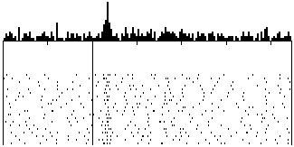
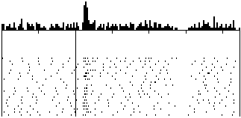
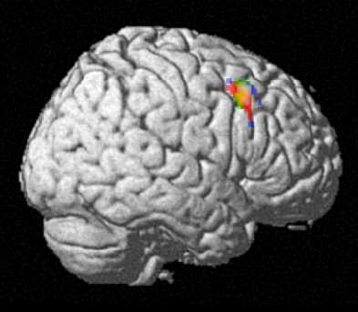
Imaging dopamine reward neurons in rhesus and
human brain: relevance to aberrant learning
in schizophrenia
Reward predicted
Reward occurs
Reward predicted
No reward occurs
Δ V = α β (λ − ΣV)
CS
Rew
Schultz
CS
Rew omission
DL-PFC
n. accumbens
s. nigra
Corlett, Fletcher et al Neuron 2004

Slide 29
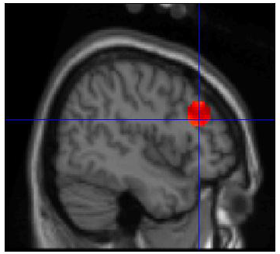
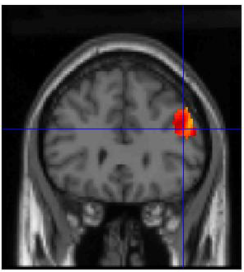
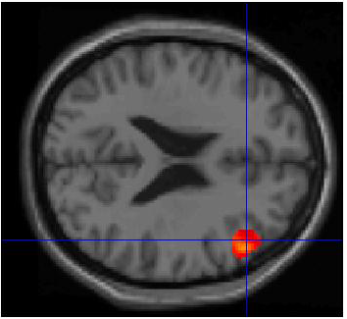
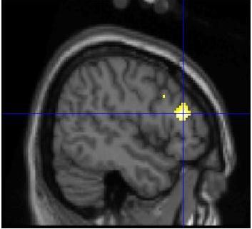
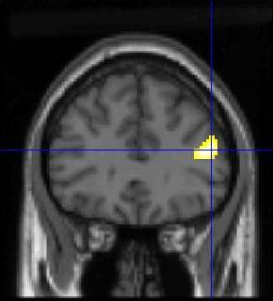
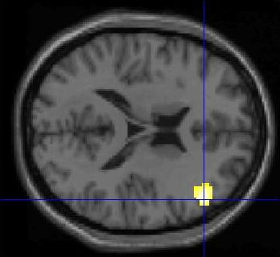
Effects of ketamine and schizophrenia on PFC error prediction signals
V
P
C
V
K
C
P= placebo: K=ketamine
v c
v c
C
P
C= controls: P = patients
V= violation; C=confirmation
Corlett et al 2007 Brain

Slide 30
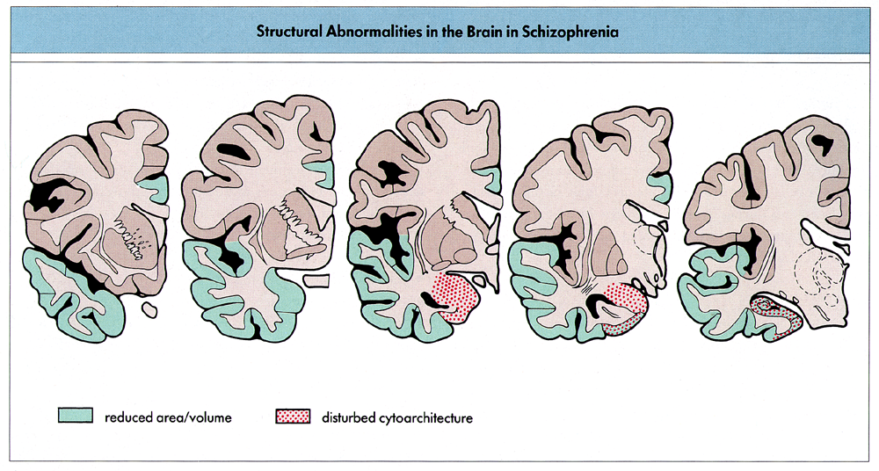
Temporal lobe and hippocampal deficits in schizophrenia

Slide 31
The Morris water-maze escape task:
test of spatial long term (‘reference’) memory

Slide 32
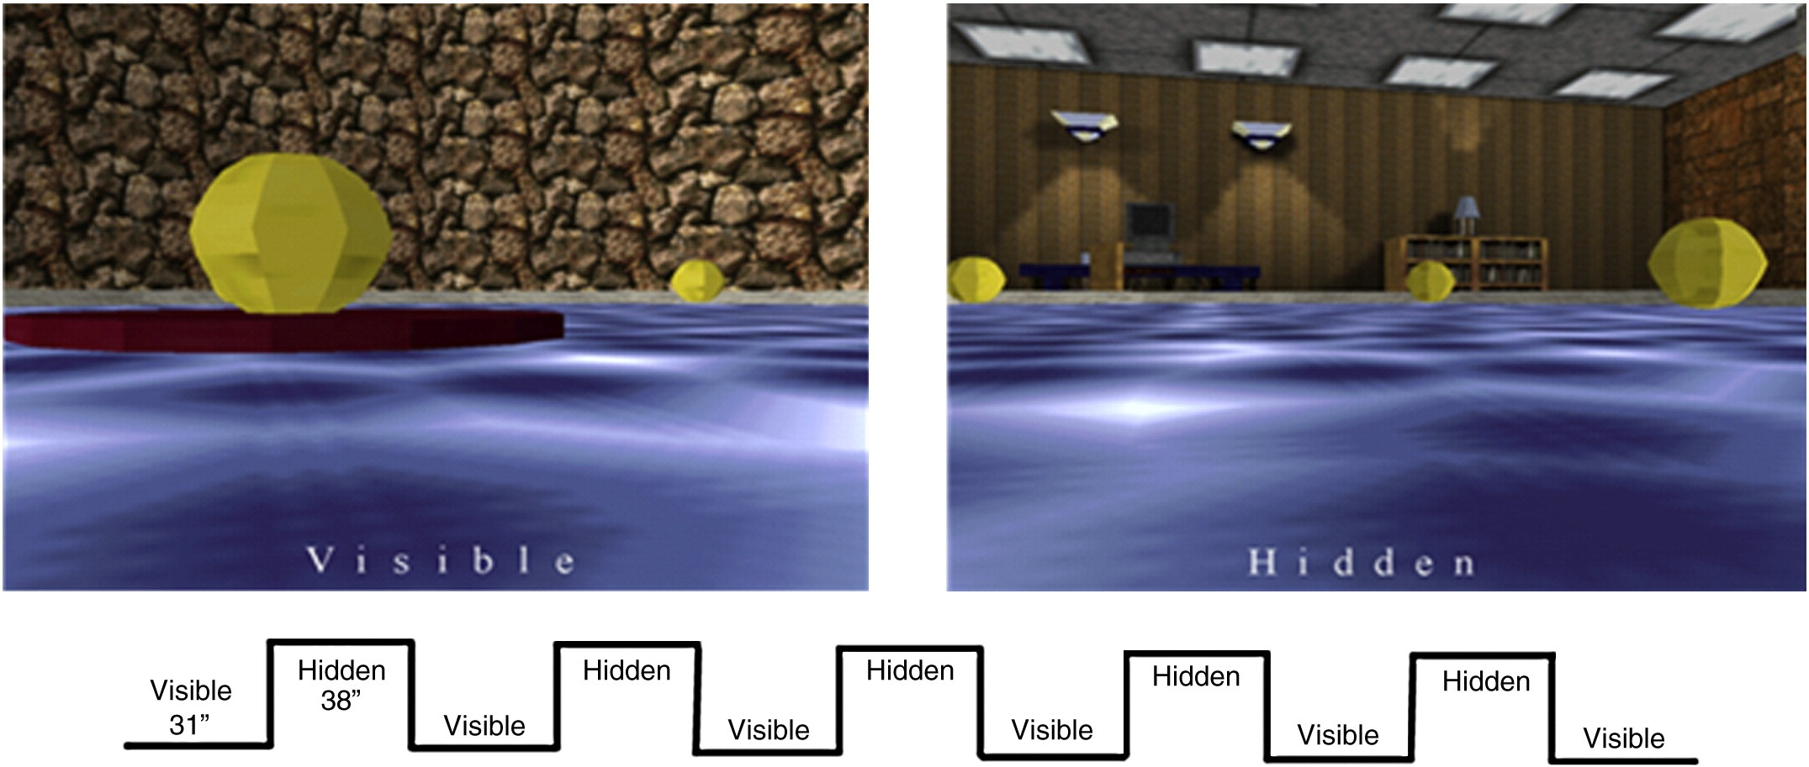
The virtual water-maze for humans
Folley et al 2010

Slide 33
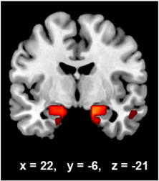
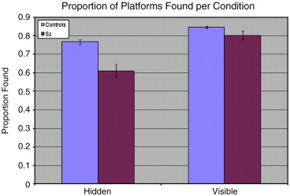
Virtual water-maze performance activates
hippocampal circuitry in healthy volunteers but not schizophrenic patients
Folley et al 2010

Slide 34
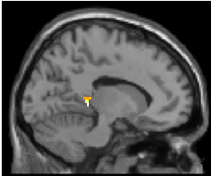
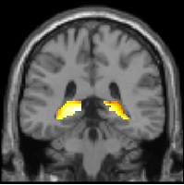
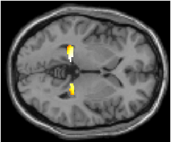
Visuospatial Paired Associates Learning (PAL)

Slide 35
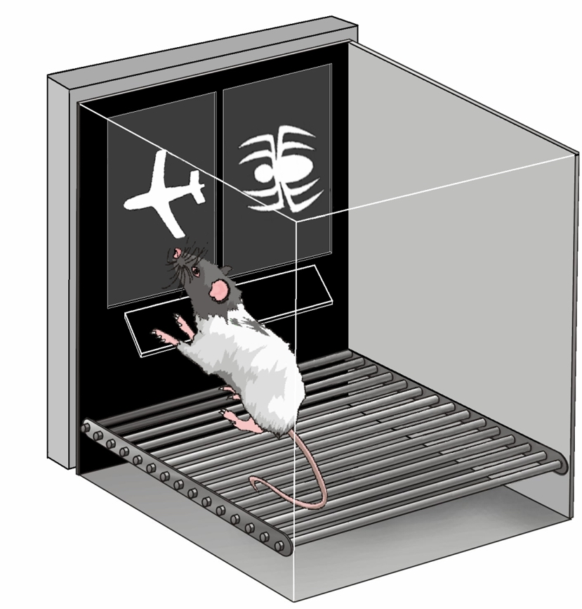
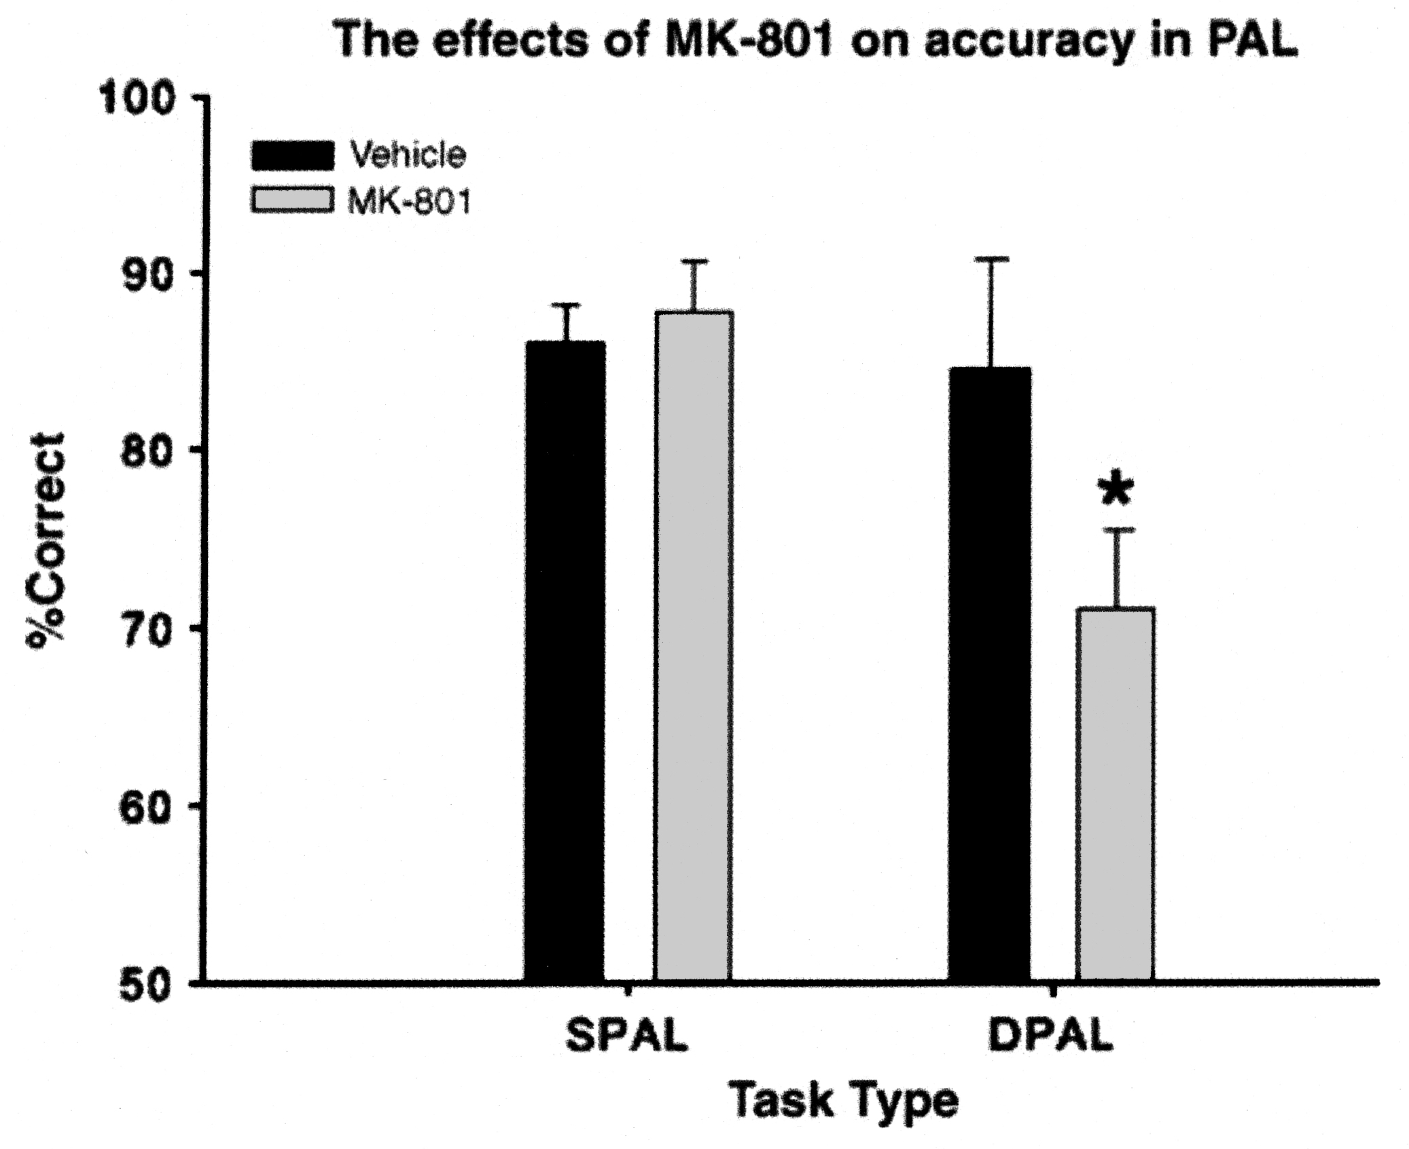
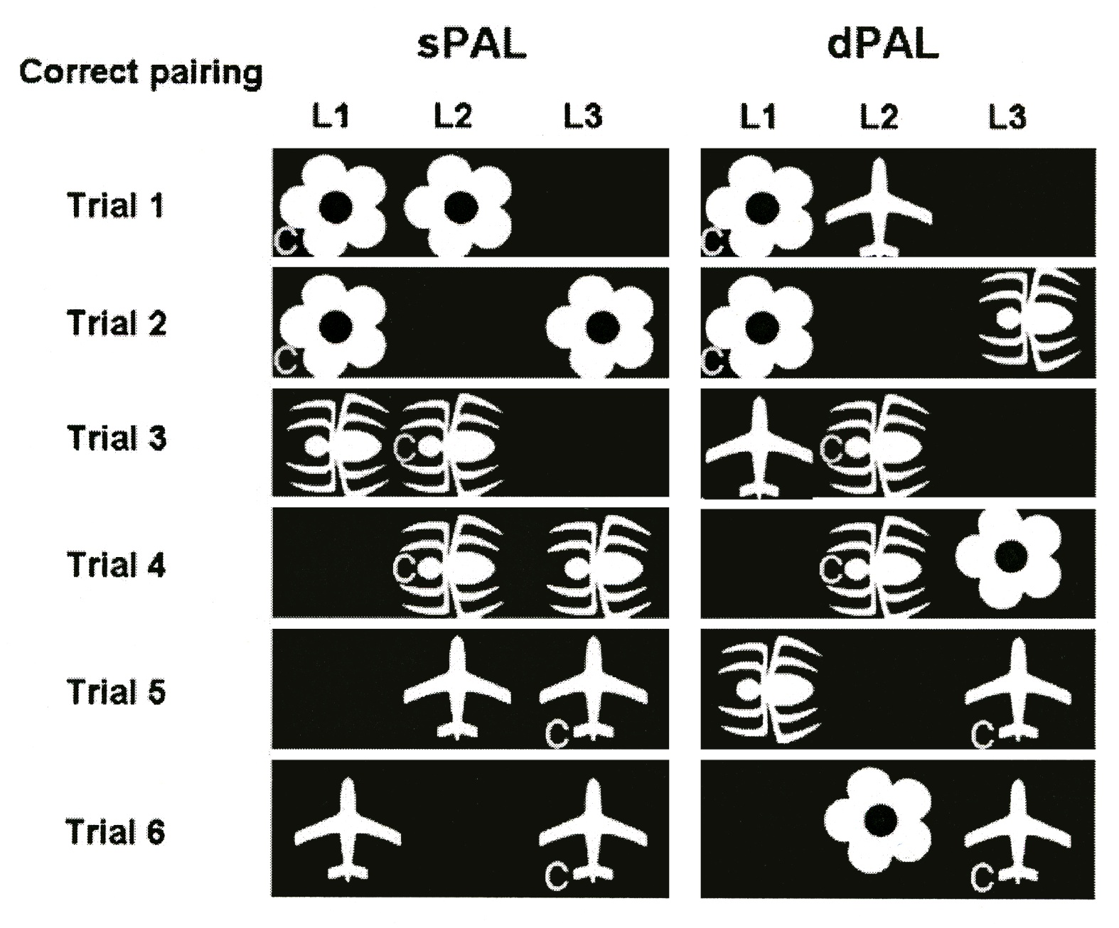
Translational neuroscience; Paired associates learning in rats and mice
Effects of intra-hippocampal NMDA receptor antagonist on PAL touch-screen performance in mice
Talpos, Bussey et al 2009: Psychopharmacology

Slide 36
Heterogeneity of cognitive impairment in a Cambridge Service of FEP (Cameo)
Individual patients at Cameo
Severely impaired performance (>2 SD below control mean)
Slightly impaired performance (>1 SD below control mean)
Intact performance
Barnett et al 2005
Missing data
Notes:
Group means versus individuals’ impairments

Slide 37
Colloborators
P Corlett
PC Fletcher
A Dickinson
MF Aitken
G Honey
ET Bullmore
BJ Sahakian
DC Turner
P McKenna
C Pantelis
EM Joyce
AC Roberts

