Slide 1
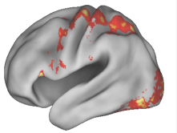
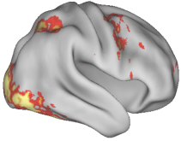
CNTRICS
Cognitive Neuroscience Treatment Research
to Improve Cognition in Schizophrenia
http://cntrics.ucdavis.edu

Slide 2
CNTRICS Executive Committee
Cameron Carter, UC Davis and Deanna Barch, Washington University St. Louis
James Breiling, National Institute of Mental Health
Robert W. Buchanan, Maryland Psychiatric Research Center
Pamela Butler, New York State University
Jonathan D. Cohen, Princeton University
Mark Geyer, University of California at San Diego
Randy Gollub, Massachusetts General Hospital
Michael F. Green, Semel Institute at UCLA and VA Greater Los Angeles Healthcare System
Judy Jaeger, AstraZeneca
John H. Krystal, Yale University
Holly Moore, Columbia University
Keith Nuechterlein, University of California at Los Angeles
Trevor Robbins, University of Cambridge
Steven Silverstein, University of Medicine and Dentistry of New Jersey
Edward E. Smith, Columbia University
Milton Strauss, University of New Mexico
Til Wykes, Institute of Psychiatry, King’s College London

Slide 3
Cognition in Schizophrenia in 2010
Impaired cognition in schizophrenia remains a disabling and treatment refractory aspect of the illness
After an initial surge of interest there are signs of reduced commitment by the pharmaceutical industry in developing treatments for impaired cognition in schizophrenia

Slide 4
Translational Neuroscience
Clinical trials targeting cognitive and
emotional processing deficits
Behavioral and neuroimaging studies
of normal and disordered cognitive
and emotional processing in humans
Behavioral, non invasive and invasive
studies of normal and disordered cognitive
and emotional processing in animal models
Animal Models
Basic molecular, cellular
and systems neuroscience
and neuropharmacology

Slide 5
CNTRICS
Traditional clinical neuropsychological tests do not isolate specific cognitive processes that are associated with discrete neural systems
Clinical neuropsychological tests are not amenable for incorporation into neuroimaging paradigms
Most mammalian species used in screening pharmacological agents cannot perform clinical neuropsychological tests
Translational research needs tools and constructs from cognitive neuroscience

Slide 6
The Challenges for CNTRICS I:Cognitive Task Development
Develop consensus regarding constructs from cognitive neuroscience that should be targeted in patients for treatment development
Need to optimize psychometric properties and practicalities of administration
Identify tasks that provide valid measurement of relevant mechanisms

Slide 7
CNTRICS I
3 consensus building meetings over 2 years
Identify cognitive systems and component processes with strong construct (and neural) validity Biological Psychiatry July 2008 Vol 64 (1)
Identify measurement and pragmatic issues related to developing cognitive neuroscience measures into translational research tools Schizophrenia Bulletin July 2008 34(4)
Identify a set of tasks for translation Schizophrenia Bulletin 2009 35(1)
RFA MH-08-090 “Adapting Basic Cognitive Measures for Clinical Assessment in Schizophrenia” and ensuing RO1’s

Slide 8
Next Steps: CNTRICS II
Now that we are on the path towards having a set of efficient tasks that will measure key cognitive mechanisms targeted for treatment in schizophrenia how can this be leveraged to enhance translational research
Imaging Biomarkers
Animal Models

Slide 9
Imaging Biomarkers
Meeting 4 (October 29-30 2009)
What is the physiological basis of the signals and how are they related to neural activity
What are the pragmatic and measurement issues related to developing these measures for use as biomarkers
Meeting 6 (fall 2010)
Identifying specific imaging biomarkers for development

Slide 10
Animal Models
Meeting 5 (April 29-30 2010)
What is homology
Issues related to the measurement of CNTRICS constructs in different species
Issues related to the use of animal models of putative pathophysiology in cognitive treatment development
Meeting 7 (Spring 2011)
Identifying specific novel animal models for development

Slide 11
Animal Models
Validity- does it really reflect the targeted cognitive and neural mechanisms of interest?
Reliability- does it have the necessary measurement properties?
Predictive Validity- a drug effect in the animal will predict a drug effect in humans
Practicality- can it work as a screen in a vertically integrated translational research program

Slide 12
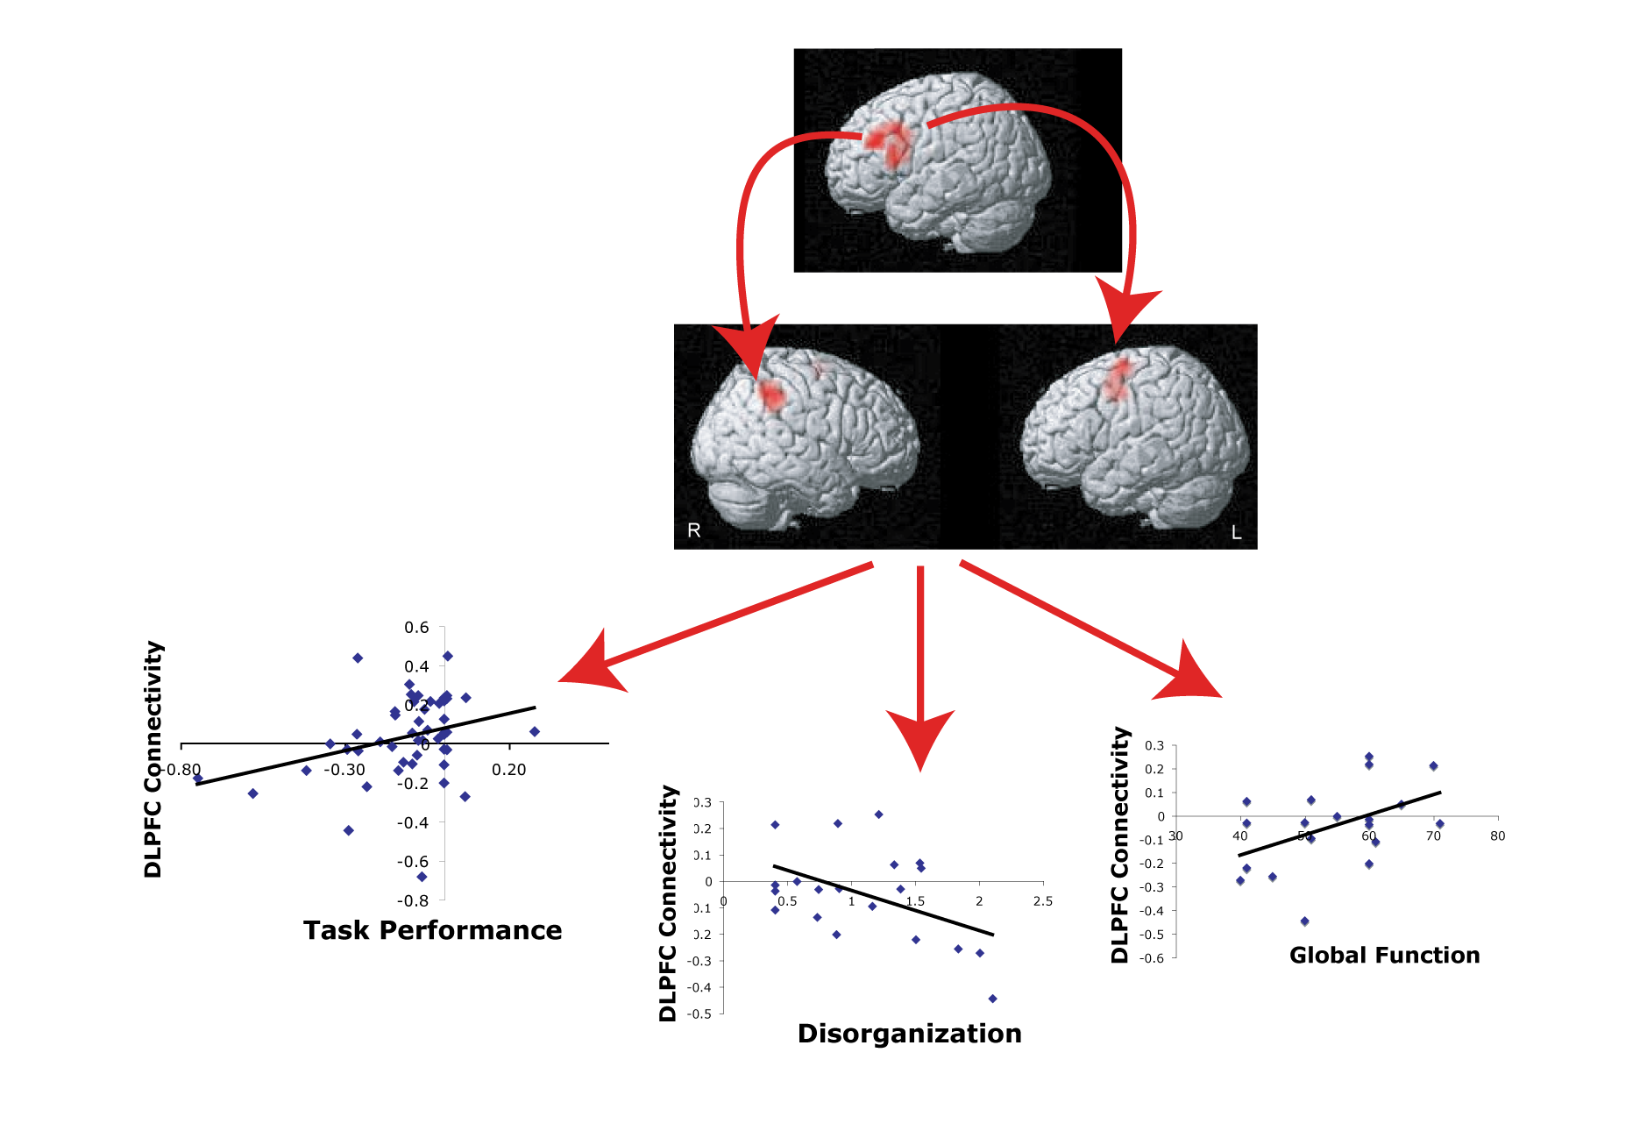
Impairment of Top Down Control in Schizophrenia: Functional Connectivity
Yoon et al, American J. Psychiatry 2008

Slide 13
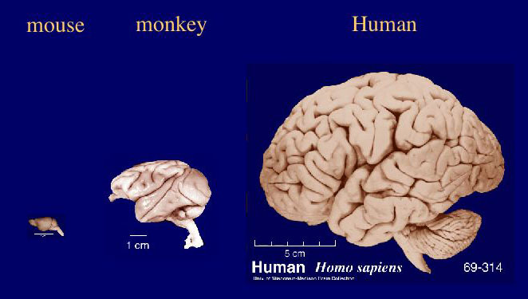
Conservation and Homology

Slide 14
AX CPT Test
“You will see a series of letters appearing at the center of the computer screen. Press the left button for any letter that comes after an A, press the right button for any other letter”

Slide 15
Conservation, Homology and Predictive Validity

