Slide 1
Developing Homologous Animal Models
for the Discovery of Treatments for
Cognitive Deficits in Schizophrenia

Slide 2
What is a Model?
Bottom-up:
Identify neural substrates of behavioral deficits via lesion, drug, or other interventions.
MANIPULATION
Recapitulates aspects of
the disease related to
etiology, genetics,
neurochemistry,
or behavioral
phenotype
MEASURE
Paradigm or
assay measuring
a specific cognitive
function that is impaired
in patients with schizophrenia
Top-down:
Identify the behavioral domains that are disrupted and how they can be reversed.
e.g. Vigilance, PPI, set shifting
e.g. PCP, neonatal hippocampal lesions
A disease model combines aspects of disease-related pathophysiology with an impairment in a test measuring a relevant cognitive function.
Adapted from Thomas Steckler

Slide 3
Types of Validity for Animal Models
Face Validity
Predictive Validity
Construct Validity
Etiological Validity
In addition, reliability is always required.

Slide 4
Face Validity
The model "resembles" the condition or specific features of the condition.
Note: “resemblance” is in the eye of the beholder and might reflect species-specific processes that are quite distinct from those underlying the "target" condition in humans.
Face validity provides important heuristic guidance, but is seldom the source of empirical validation.

Slide 5
Predictive Validity
The model system makes accurate predictions that match the human condition being modeled.
  behaviors used in predictive models may lack face validity, i.e. they need not resemble the human condition to have utility.
Pharmacological Predictive Validity:
  A subset of predictive validity
  The model system accurately discriminates effective treatments from other treatments.

Slide 6
An Example of Pharmacological Predictive Validity: Canine Emesis
The ability of drugs to prevent apomorphine-induced emesis in dogs predicts their potency as antipsychotic agents in humans, despite the fact that face validity is not achieved, i.e. “barfing” dogs don’t “look” psychotic. (Freedman & Giarman 1956)
Adapted from Neal Swerdlow

Slide 7
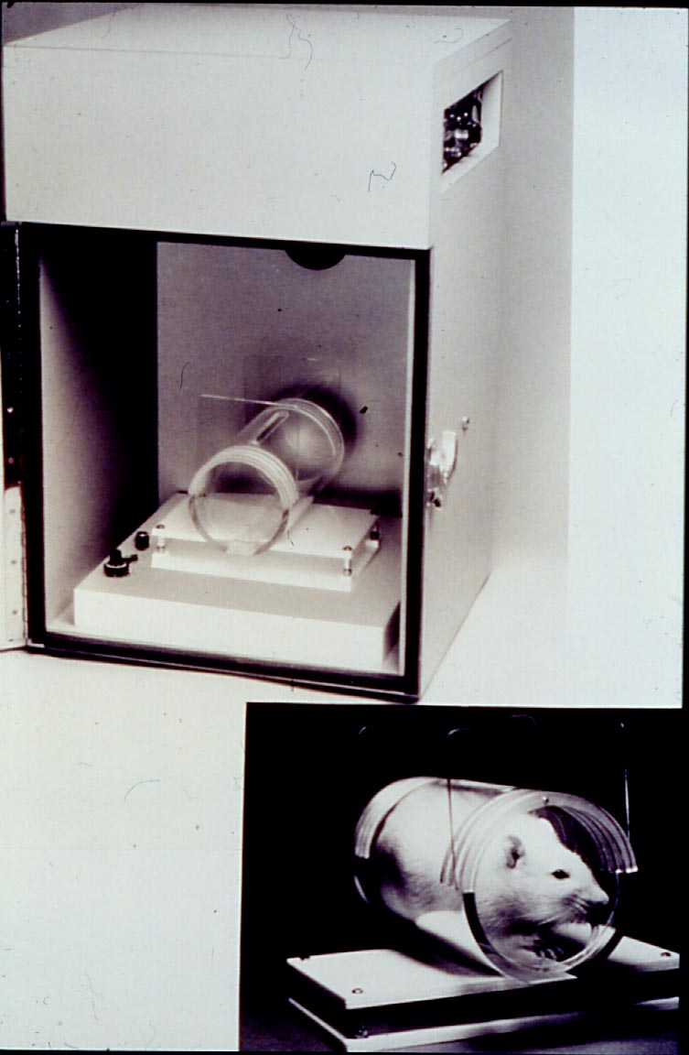
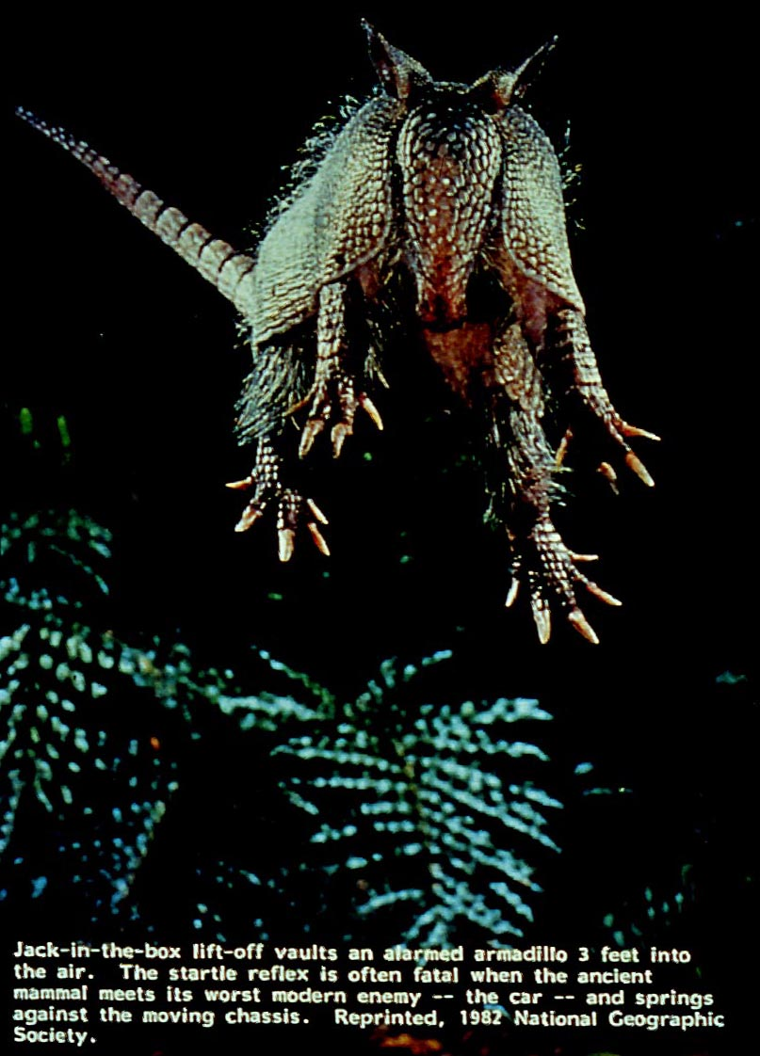
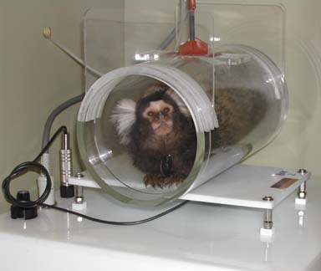
Prepulse Inhibition: A Homologous Measure of Perceptual Gain Control

Slide 8
Predictive Validity of PPI: Similar Parametric Effects Across Species
Adapted from Neal Swerdlow

Slide 9
Predictive Validity: Similar Drug Effects on PPI in Rats and Humans
DRUG
Amphetamine
Bromocriptine
Haldol & Bromo
Apomorphine
Psilocybin
Nicotine
Clonidine
Diazepam
EFFECT
Reduce
Reduce
Reversed by Haldol
Reduce in PD patients
Reduce
Increase
No effect
No effect
REFERENCE (humans)
Hutchinson et al. 1997,1998
Abduljawad et al. 1997,1998
Abduljawad et al. 1998
Morton et al. 1995
Vollenweider et al. 2007
Kumari et al. 1996
Abduljawad et al. 1997b
Abduljawad et al. 1997b
But note that mis-matches are also seen: e.g. ketamine, MDMA
Adapted from Neal Swerdlow

Slide 10
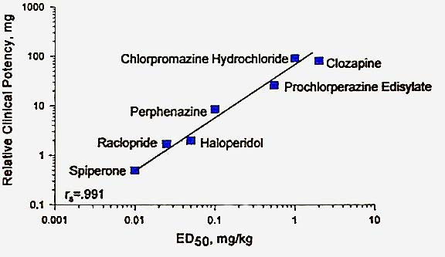
Pharmacological Predictive Validity: Antipsychotics Block Apomorphine Effects on PPI in Rats
Adapted from Neal Swerdlow

Slide 11
Construct & Etiological Validity
Referring to a Measure:
  CONSTRUCT VALIDITY
  ala Cronbach & Meehl: The measure accurately assesses that which it is intended to measure.
Referring to a Manipulation:
  ETIOLOGICAL VALIDITY
  i.e. the model system reflects the appropriate biological substrates (i.e. exhibits homology)
  The model system reflects the pathophysiology of the human disorder.

Slide 12
PPI Modulation Circuitry
Hippocampus
Frontal Cortex
ACh
GLUTAMATE
Nuc. Acc.
GLUTAMATE
GLUTAMATE
5HT
Amygdala
GABA
DA
5HT
Ventral
Pallidum
Ventral
Raphe
Tegmentum
GABA
Nuclei
Startle
Reflex
Circuit
Adapted from
Swerdlow, Geyer & Braff,
Psychopharmacology, 2001
Pedunculopontine
Notes:
6

Slide 13
Predictive and Construct Validity: PPI Deficits in Huntington’s Disorder
Percent Prepulse Inhibition
Predicted by PPI deficits in rats after striatal lesions (quinolinic acid, 3-nitropropionic acid)
Adapted from Neal Swerdlow

Slide 14
PPI Deficits in Mice Transgenic for the HD Gene
(Carter et al. 1999)
Adapted from Neal Swerdlow
Notes:
HM: I would consider this construct validity (with regard to circuit function) in a model of etiologic validity.

Slide 15
MAM E17: A Pathogenic Rat Model Designed to Mimic a Developmental Cause of Schizophrenia
non-progressive increase in ventricular volume
reduction in size of hippocampus, parahippocampal cortex
reduced thickness of frontal cortex
normal number of neurons but increased neuron density in prefrontal and temporal cortex
decreases/disruption of PV interneurons in temporal cortex
Adapted from Holly Moore

Slide 16
PPI Deficit in MAM E17 Offspring
Mimics That Seen in Schizophrenia
*
*
Braff, Grillon & Geyer, 1992
Moore, Jentsch, Ghajarnia, Geyer & Grace, 2006
Adapted from Holly Moore

Slide 17
Features of a Useful Animal Model
It is a preparation developed in an animal for the purpose of predicting the effect of a manipulation on cognitive function in a human condition
It must therefore be amenable to cross-species studies
It must exhibit high construct validity relevant to the clinical model
It must have predictive validity, i.e., provide a reliable signal of efficacy across species
It can be used for confident go/no-go decisions in a drug development program
Adapted from Thomas Steckler

Slide 18
What is a Translational Animal Model?
Translation is not a new approach, but has increased emphasis on bidirectional flow of information, with constant feedback from the clinic to the preclinical researcher to ensure refinement and innovation in preclinical models.
Adapted from Thomas Steckler

Slide 19
DAY ONE: MEASURES
Focus on Dependent Variables:
  i.e. measures of the relevant construct
Construct validation:
  ala Cronbach & Meehl
  i.e. does the test measure the construct it is intended to measure?
Homology:
  in the sense of comparability of neural substrates across species

Slide 20
DAY TWO: MANIPULATIONS
Focus on Independent Variables:
  Perturbations affecting the substrates of the cognitive construct
  Perturbations relevant to pathophysiology of schizophrenia
Homology, related both to:
  Comparability of neural substrates
  Etiological validity vis-à-vis schizophrenia
Specificity of treatments for the schizophrenia population

Slide 21
Challenges for Pro-cognitive Treatments for Schizophrenia
Our understanding of the neuroscience behind cognitive changes in schizophrenia is limited.
  There is no unitary hypothesis for the cause(s) of cognitive deficits
  The diagnostic syndrome may reflect many different etiologies
  No consensus on the underlying neurobiology
Cognition is not a unitary concept.
  5 – 12 cognitive domains are affected, each with different substrates
  Is it realistic to seek treatments that will improve cognition globally?
  What would be the most relevant domains that need to improve?
No reliable and valid biomarkers for cognitive dysfunction have been validated as yet.
No validated drug targets exist for improving cognition that can be used as positive controls, although many suspected targets exist
Adapted from Thomas Steckler

Slide 22
Notes:
3
2
2
2
1
1

Slide 23
Notes:
3
2
2
2
1
1

Slide 24
Notes:
3
2
2
2
1
1

