Slide 1
Animal models of episodic memory in comparative perspective
Elisabeth A. Murray, Ph.D.
Laboratory of Neuropsychology
National Institute of Mental Health, NIH

Slide 2
Know then thyself, presume not God to scan;
The proper study of Mankind is Man…
He hangs between; in doubt to act, or rest,
In doubt to deem himself a God, or Beast
—— Alexander Pope, 1733

Slide 3
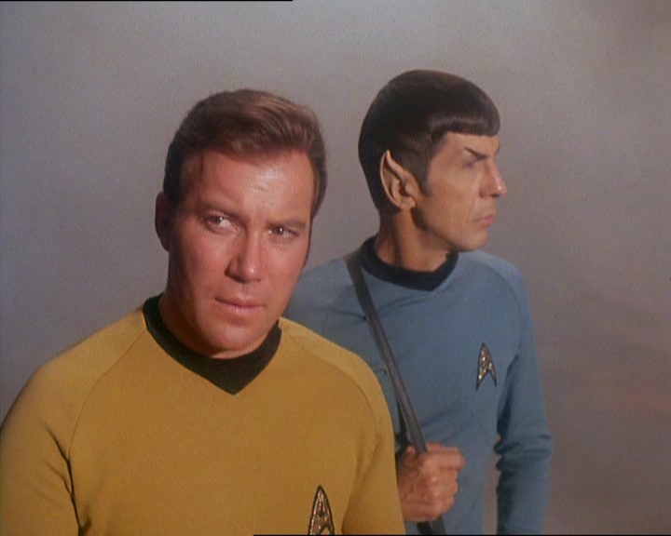
The Prime Directive:
Similarity without reference to the LCA is similarity without meaning
(we will come back to this)
That is romantic, and in 1733 man’s place in the biological world was a mystery.
But now we now know how we fit in.
For each species that enters a psychology lab, we have descended from a “last common ancestor”– the LCA
Which leads to:

Slide 4
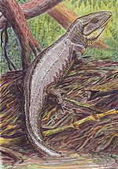
Let’s look at an example highly relevant to episodic memory
The cladogram below shows that the
amniotes leading to mammals and those
leading to birds diverged early in amniote history
placentals
mammals
marsupials
LCA
monotremes
amniotes
turtles
snakes & lizards
crocodiles
birds
dinosaurs*
Depiction of a primitive amniote
(the LCA of primates & birds)
lissamphibians

Slide 5
Similarities between human and scrub jay “episodic” or “episodic-like” memory are very superficial
LCA:
~320
million
years
ago
Humans
(conscious episodic memory,
mental time travel, self-reflection,
embedding oneself in events)
placentals
mammals
marsupials
monotremes
amniotes
turtles
snakes & lizards
crocodiles
Scrub jays
(what, where, when
conjunctions)
birds
dinosaurs*
lissamphibians

Slide 6
If the LCA had conscious event memory and MTT, there should be evidence for such advanced cognition in its other descendants
Putting these ideas in a comparative context does not disprove anything, but ask yourself: does it really pass the ‘smell test’?
placentals
mammals
marsupials
monotremes
amniotes
Scrub jays and humans show similarities, but these are likely due to parallel and independent evolution
Otherwise, one has to
believe that the LCA, a
fairly primitive amniote that lived about 320 million years ago, had the same advanced cognitive capacities that
characterize human episodic memory
turtles
snakes & lizards
crocodiles
birds
dinosaurs*
lissamphibians

Slide 7
Anything can be homologous:
        Structures
        Behaviors
        Physiological processes
        Metabolic pathways
        Genetic sequences
        et cetera
Provided that they have been inherited from the LCA
If not, then any similarities are homoplaseous
and all bets are off about mechanisms & “circuits”
Similarity is not enough: similarity without reference to
the LCA is similarity without meaning

Slide 8
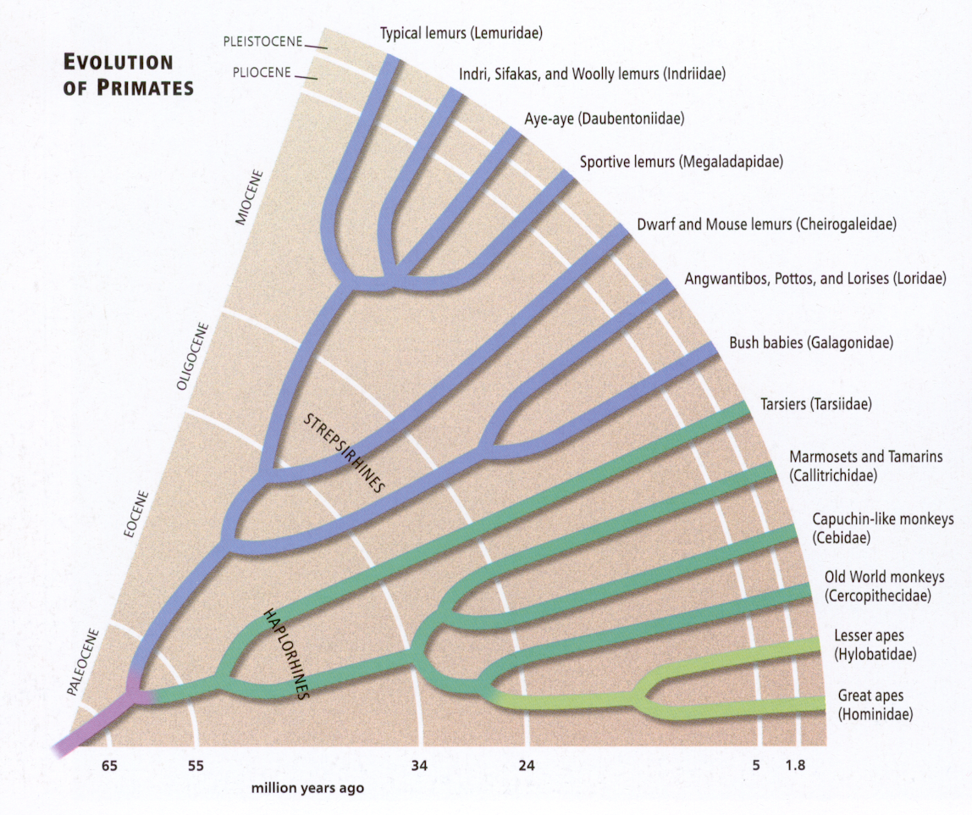
Monkeys, in contrast to scrub jays, diverged from us “only” ~30 million years ago
platyrrhine anthropoids
anthropoids
catarrhine anthropoids
hominoids
chimps &
bonobos split

Slide 9
So what can monkeys tell us about our “constructs” when we can’t study the LCA?
Construct 1: Episodic memory
Construct 2: Recognition memory

Slide 10
So what can monkeys tell us about memory when we can’t study the LCA?
MTL damage in humans produces amnesia, but early attempts to replicate effects on memory after MTL lesions in monkeys failed
  no effects of MTL lesions on object discriminations
    Orbach, Milner and Rasmussen, 1960
    Correll and Scoville, 1965
  no effects of MTL lesions on delay tasks
    Correll and Scoville, 1967
Roughly 20 years without major advances in monkey “model” of human memory
Is there a species difference? Have humans and monkeys diverged that much??

Slide 11
Then, Mishkin concluded that humans and monkeys are alike, after all
“This close correspondence of [MTL lesion] effects in the two species implies . . . that the clinical syndrome, like the experimental one, could indeed be the result of combined damage to the amygdala and hippocampus. . .”
Mishkin et al. (1982)
An apparent behavioral homology, and so …

Slide 12
The orthodox monkey model of memory was born:
Monkeys and humans have inherited a medial temporal lobe “memory system” from their LCA
This system includes the episodic memory mechanism
How did this orthodoxy come about?

Slide 13

Delayed nonmatching-to-sample (DNMS)
Sample
presentation
+
10 sec
Choice
test
-
+
30 sec
Gaffan, 1974; Mishkin and Delacour, 1975

Slide 14
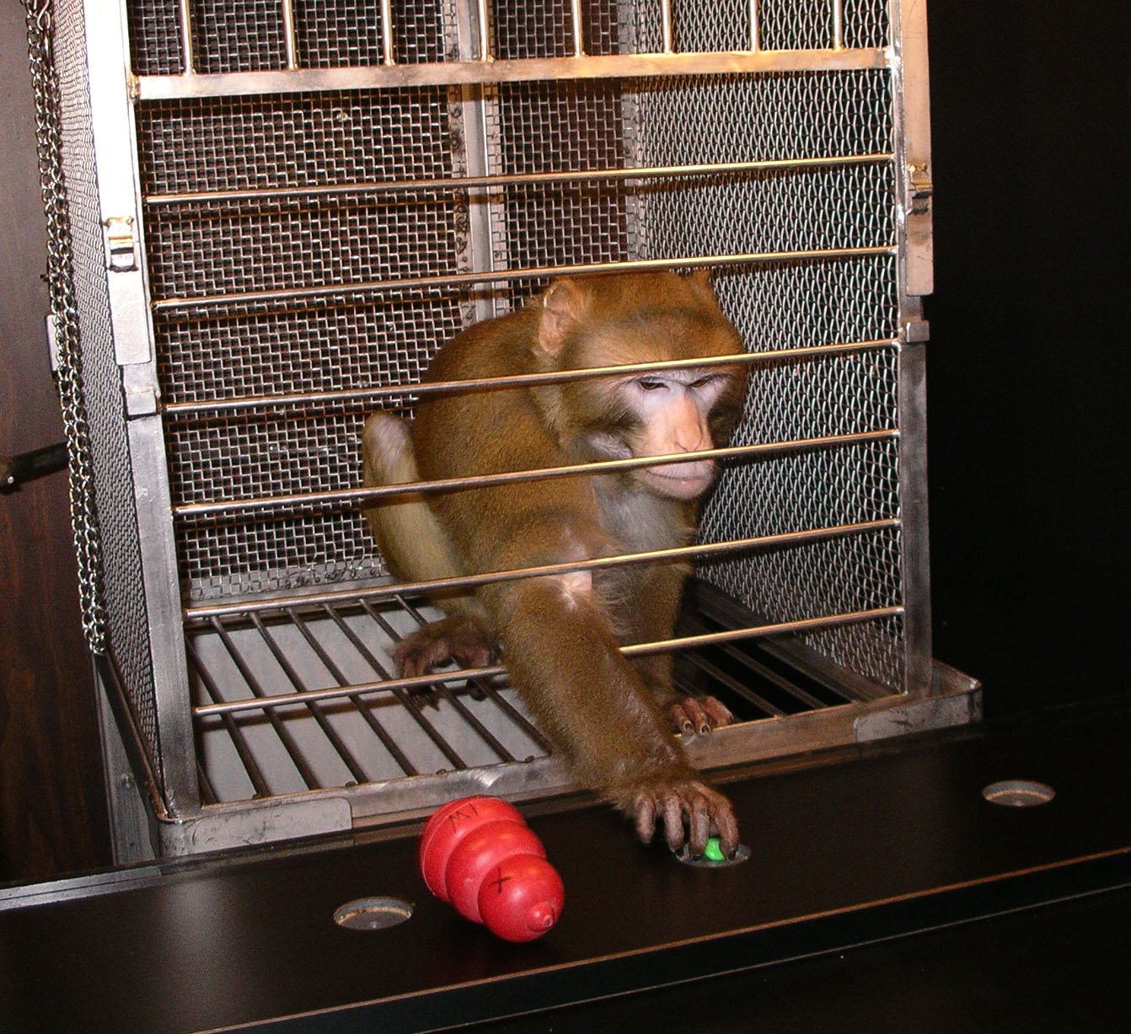

Slide 15
Recognition memory
100
N
90
A
80
H
Percent correct
70
60
Said to be
A+H
50
List length
1
1
1
1
3
5
10
Delay
10"
30"
60"
120"
60" +
100" +
200" +
Mishkin (1978)
Notes:
15

Slide 16
This finding & others led to the current orthodoxy:
    MTL in monkeys has the same function as MTL in humans
    In humans, that function is conscious memory
    But in monkeys, all memories are assessed by performance, and so we have a problem
“the fundamental distinction is between the capacity for conscious recollection of facts and events (declarative memory) and nondeclarative memory, which supports … forms of memory that are expressed through performance rather than recollection.”—Clark, Manns & Squire, 2002

Slide 17
Despite this problem, the main tenets of the current orthodoxy remain:
    MTL is a single “thing”
    It (and therefore the hippocampus) subserves conscious (declarative) memory
      as demonstrated by the role of hippocampus in visual recognition (DNMS)
    It does not contribute to subconscious (procedural, implicit) memory
    It does not function in perception
Memory
Declarative
Procedural
Facts Events Skills Priming Classical Other
Squire, 1987

Slide 18
But the current orthodoxy is wrong:
    Monkey studies show that MTL is NOT a single “thing”
    Monkey studies also show that the hippocampus is NOT critical for visual recognition
    In humans, MTL DOES contribute to implicit spatial memory (Chun & Phelps, 1999) & perception (Lee et al., 2005a, b)
    Monkey and human studies show that part of the traditional MTL (PRh) DOES function in perception (Murray, Bussey & Saksida, 2007)
The first two points are now taken up, in turn
The other two are topics for another time

Slide 19
The MTL is not a THING:
Each part contributes to perception & memory in its own specialized way
 | A(IBO) | H | Rh
DNMS/FA* tasks | 0
Reinforcer devaluation |  | 0 | 0
Arbitrary mapping | 0
(IBO)
(IBO)
(ASP)
* Feature ambiguity tasks
0 = no effect

Slide 20
The hippocampus is NOT necessary
for recognition memory: with or without amygdala
100
90
Control
80
Percent Correct Responses
A+H
(IBO)
Murray & Mishkin (1998)
70
60
Rh
Meunier, Bachevalier,
Mishkin & Murray (1993)
50
10
30
60
120
3
5
10
Delay (sec)
List Length

Slide 21
The hippocampus is also NOT necessary for other aspects of stimulus memory
 | H | A(IBO) | HA(ASP) | PRh/Rh
Trial-unique DNMS | 0 | 0
Visual-visual paired assoc. | 0
Crossmodal DNMS | 0 | 0
0 = no effect

Slide 22
What about the role of hippocampus in DNMS?
Previously thought to be due to H or H+A lesions
Shown instead to be due to Rh lesion, in most cases
Why only “most” cases?
Stimulus set size strategy H lesion effect
Very small sets (2): STM no¹
Large sets (300-400): recency yes²
Very large sets (>1000): familiarity no³
¹ Correll and Scoville, 1965
² Beason-Held et al., 1999; Zola et al., 2000; Gaffan, 1974
³ Murray & Mishkin, 1998; Nemanic et al., 2004

Slide 23
The failure of the orthodox memory model opens the field to alternative views, which dispense with the MTL as an entity subserving a “memory system”:
    Multiple-trace theory (Moscovitch & Nadel. 1997)
    Temporal-stem theory (Gaffan, 2002)
    BIC (Eichenbaum, Yonelinas, Ranganath, 2007)
    Hippocampal-prefrontal theory (Murray & Wise, 2010)
For today, I will focus on 3 possible hippocampal functions, in turn:
    Hippocampus for spatial processing
    Hippocampus for fast learning
    Hippocampus for scene memory

Slide 24
The hippocampus was
previously thought to be required for 3 types of spatial memory
spatial reversal, spatial matching, and object-place associations
(all wrong)
 | H(IBO) | H(ASP) | PHC*
Spatial reversals | 0
Spatial DNMS | 0
Object-place association | 0
*PHC = parahippocampal cortex

Slide 25
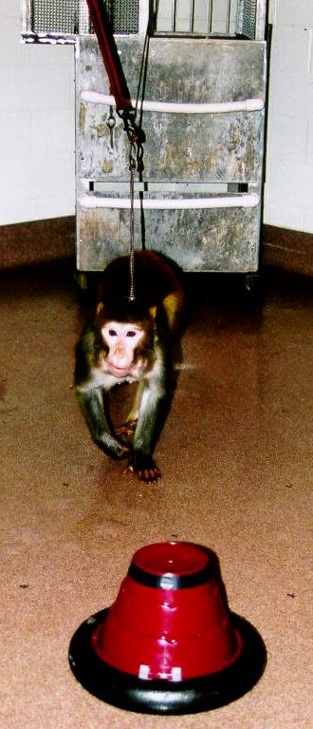
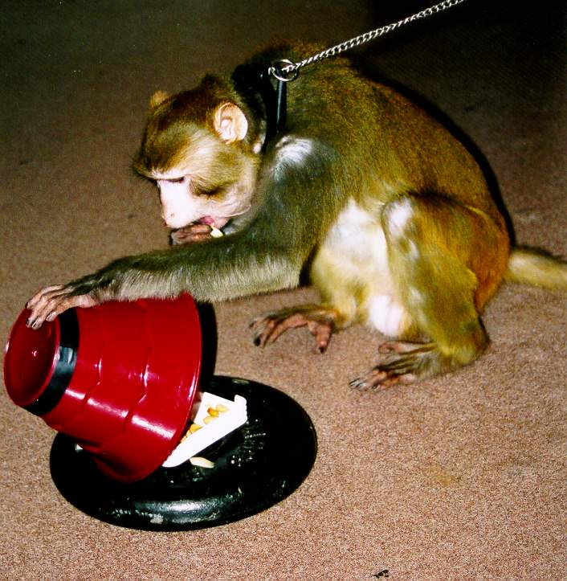
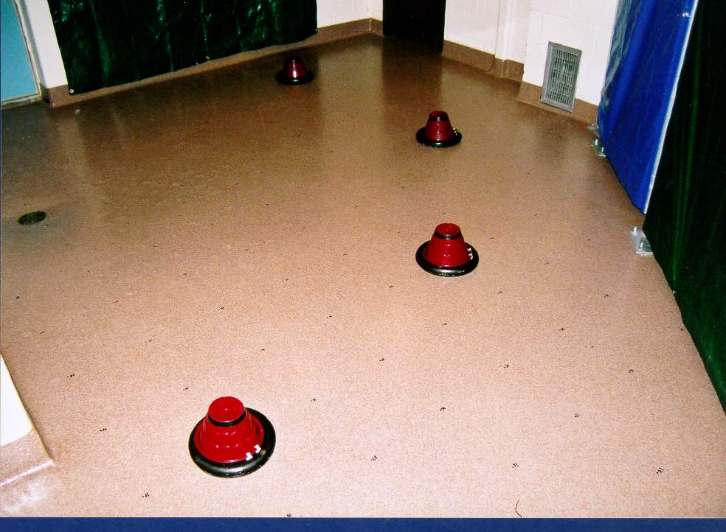
Open-field spatial memory test

Slide 26
Open-field spatial memory test
30
25
20
Delay titration
15
score (min)
10
5
0
Control
Hippocampal
Hampton et al. (2004)

Slide 27
Arbitrary associations
Spatially directed responses (joystick task)
O
u
Left
T
O
k
u
Right
L
h
Down

Slide 28
Arbitrary associations
Nonspatial responses (touchscreen task)
T
p
8 Touches
< 2 seconds
TAP
S
h
SHORT HOLD
2-4 seconds
L
h
LONG HOLD
> 4 Seconds

Slide 29
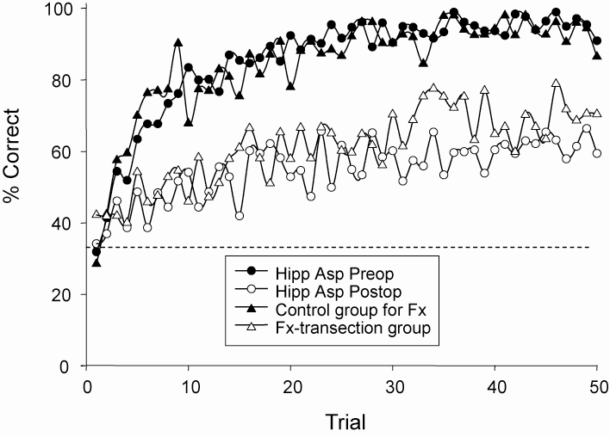
Fast associative learning
Controls
Fx or H
lesions
chance
Brasted et al. 2005

Slide 30
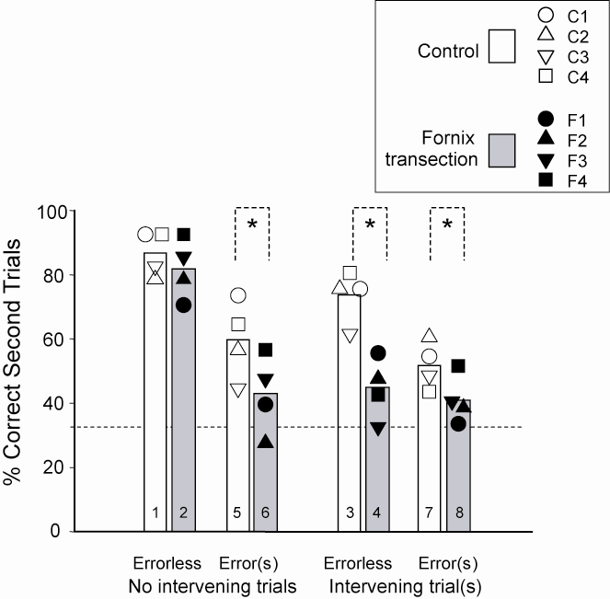
One-trial learning
PFv+o lesions: abolish 1-trial learning
But w/o prior errors or intervening trials, Fx lesions do not
Fx lesions block 1-trial
learning. The loss of this
fast, event-capture memory
probably slows the overall
learning rate
PFv+o
Brasted et al. 2005

Slide 31

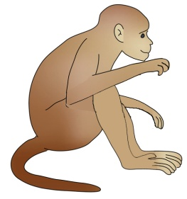
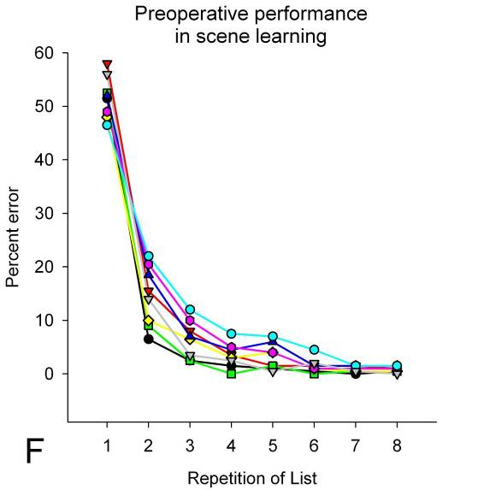
Object-in-place scenes
Courtesy M. Baxter

Slide 32
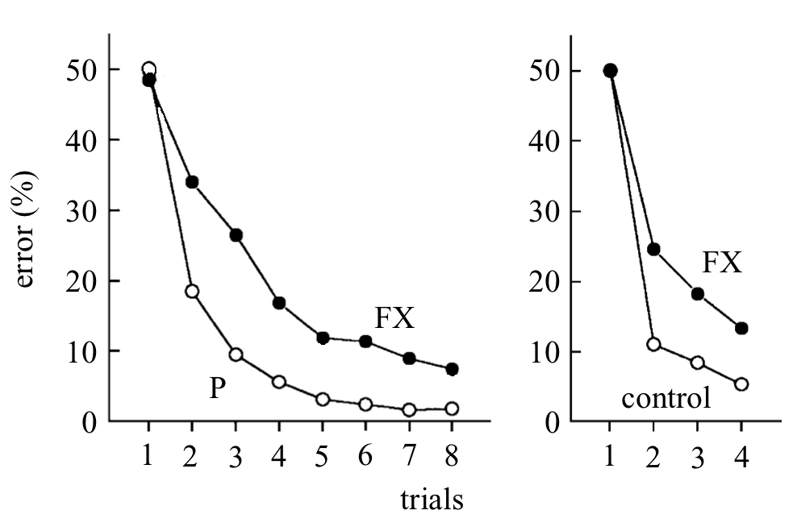
Object-in-place scenes
monkeys
humans
Adapted from Aggleton et al. (2000) Brain and
Gaffan (2002) Philos Trans R Soc Lond B Biol Sci
Courtesy M. Baxter

Slide 33
Hippocampus
Hippocampus essential for spatial memory in naturalistic conditions, fast associative learning & object-in-place scenes task, but why?:
  Navigation/spatial?
  Large scale?
  Episodic?
  Explicit recollection?
  Fast learning?
Arbitrary visuomotor associations, objects-in-place scene tasks benefit from fast, event-capture memory
Not just spatial: Fornix essential for both spatial and nonspatial visuomotor mappings

Slide 34
Hippocampus: episodic vs. semantic memory
Children with early hippocampal damage: initially reported to have impairments in episodic memory, with sparing of semantic memory (Vargha-Khadem et al 1997; 2001).
More recent studies showed that these lesions DO impair the acquisition of semantic memories (Gardiner et al 2008; Holdstock et al 2002; Manns et al, 2003).
Holdstock et al (2002): hippocampus crucial in the rapid acquisition of semantic information, just as in rapid acquisition of episodic memory (Kapur, 1994).
Thus, the distinction between the hippocampal cortex and other cortical areas could relate to rapid versus slow learning (McClelland, McNaughton, & O'Reilly, 1995) rather than to episodic versus semantic memory.

Slide 35
So what, after all, have monkeys and humans inherited from their LCA?
A hippocampus-dependent fast learning mechanism
The hippocampus is, of course, a part of the cerebral cortex; other parts of the cortex, including PRh, subserve slow learning
This fast learning system is important for episodic memory (event capture), but not only that
And the hippocampus does what it has been doing since being inherited from the LCA of the amniotes

Slide 36
Discussion points:
What is the state of the field in measuring this “construct”? Are there significant limitations in comparing the “construct” across species?
Animals models are problematic because the constructs (declarative memory, cognitive memory, episodic memory) depend on consciousness, by whatever label used for it.
Are the known neural substrates relevant to neural circuits recruited by this “construct” in humans?
Yes, but similarity without reference to the LCA is similarity without meaning.
Ideas about how a treatment strategy (pharmacological, cognitive/behavioral) could target this construct
A focus on ‘fast’ learning, as opposed to dogmatic ‘tests’ of declarative memory in animals is one way forward.

Slide 38
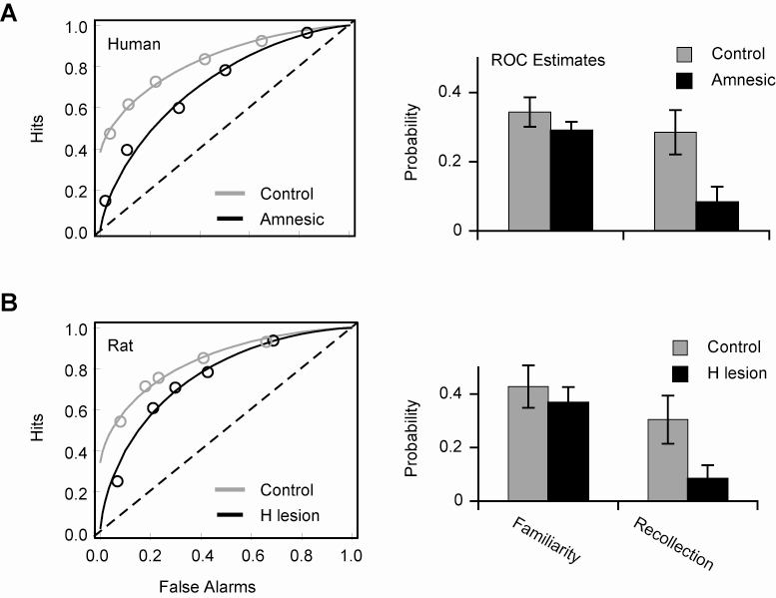
Hippocampus for recollection, not familiarity
Courtesy H. Eichenbaum

