Slide 1



Dopamine, Motivation and Schizophrenia: Research with Rodent Models
Department
of Psychology
Program
in Neuroscience
John D.
Salamone PhD
CNRTRICS 2010
RO1MH78023
RO1NS047261
DA009158
Notes:
1

Slide 2
BACKGROUND
DA and Schizophrenia: Strong and Weak Forms of the DA Hypothesis
STRONG form of DA Hypothesis: Excessive transmission in DA system directly causes schizophrenia.
…Evidence is unclear.
WEAK form of DA Hypothesis: DA transmission regulates the processes involved in the generation of the symptoms of schizophrenia.
…evidence is overwhelming.
Salamone 2003

Slide 3
DA and Schizophrenia: Bi-directional Modulation of Schizophrenic Symptoms with DAergic drugs
D2 antagonists yield antipsychotic effects
D2 affinity highly correlated with antipsychotic potency
D2 occupancy at therapeutic doses of antipsychotics
Drugs that augment DA transmission induce or exacerbate symptoms of schizophrenia (e.g. amphetamines, cocaine, L-DOPA)
DA D2 transmission somewhere in the brain is a “choke point” that can modulate psychotic symptoms
Analogous to how beta adrenergic transmission can modulate blood pressure.

Slide 4
DA and Motivation: Behavioral Effects of Antipsychotic Drugs
HIGH DOSES OF D2 ANTAGONISTS
Induce akinesia, catalepsy, tremor; related to motor side effects of antipsychotics
Reduce food intake- effects attributed to motor impairments produced by actions on the ventrolateral neostriatum
LOW DOSES OF D2 ANTAGONISTS
Selective effects on aspects of appetitive and aversively motivated behavior (e.g. food reinforced lever pressing; avoidance behavior; behavioral activation)
Many of the motivational effects of impaired DA transmission are thought to be related to actions on mesolimbic DA system

Slide 5
Behavioral Functions of Mesolimbic DA System
Involved in …
Instrumental learning (appetitive and aversive)
Responsiveness to conditioned stimuli
Pavlovian-Instrumental transfer
Sensorimotor gating
Event Prediction (appetitive and aversive)
Aspects of drug self-administration
Incentive Salience
The activating effects of stimulant drugs such as amphetamine, cocaine
Behavioral activation, effort-related functions

Slide 6
Conceptual Framework: Motivation
Definitions:
- The set of processes through which organisms regulate the probability, proximity and availability of significant stimuli (Salamone 1992, 2010; Salamone et al. 1997).
- The process of arousing actions, sustaining the activity in progress, and regulating the pattern of activity (Young 1960).
Motivated behavior takes place in phases:
instrumental (or appetitive) -> consummatory
Motivation has activational and directional aspects:
- directional aspects: behavior is directed towards or away from particular stimuli or conditions
- activational aspects: behavior is characterized by high levels of activity, vigor, persistence
Duffy 1963; Cofer and Appley 1964; Salamone 1988, 2010

Slide 7
Activational Aspects of Motivation
Vigor, speed or persistence of work output in goal-seeking behavior are fundamental aspects of motivation, and an area of overlap between motivational and motor processes
Enable organisms to exert the effort necessary for overcoming response costs or constraints
Organisms continually make Effort-Related decisions based upon cost/benefit analyses
Implications for psychiatry: dysfunctions of behavioral activation are related to psychomotor slowing, anergia and fatigue seen in depression, multiple sclerosis, parkinsonism; also, side effects of antipsychotic drugs
Notes:
7

Slide 8
Important Distinctions Between Aspects of Motivation that are Important for Understanding DA
Activational vs. Directional (Salamone 1988)
Preparatory vs. Consummatory (Blackburn et al. 1989)
Instrumental vs. Consummatory (Salamone 1991)
Wanting vs. Liking (Berridge and Robinson (1998)
Anticipatory vs. Consummatory (Ikemoto and Panksepp 1996)
Food Seeking vs. Food Taking (Foltin 2001)
Ethanol Seeking vs. Ethanol Intake (Czakoski et al. 2002)
Anticipatory vs. Hedonic (Barbano and Cador 2007)
Notes:
8

Slide 9
Motivational Effects of Antipsychotic Drugs
Intra-accumbens injections of D2 Antagonists and low systemic doses DO NOT:
Reduce food intake or suppress appetite
Blunt the primary or unconditional motivational properties of food
Impair discrimination of the magnitude of food reinforcement
Reduce appetitive taste reactivity to food
Salamone et al. 1991, 1997, 2002, 2007, 2009, 2010; Baldo et al. 2002; Kelley et al. 2005

Slide 10
Motivational Effects of Antipsychotic Drugs
Intra-accumbens injections of D2 Antagonists and low systemic doses DO:
Reduce the behavioral activation produced by motivational stimuli
Blunt Pavlovian-Instrumental transfer
Impair appetitive and aversively motivated instrumental behaviors
Reduce food-reinforced instrumental behaviors in a manner that interacts with the response requirements
Reduce the tendency to work for reinforcers
Alter effort-related decision making, biasing animals towards low effort alternatives
Salamone et al. 1991, 2007, 2009, 2010; Kelley et al. 2005; Robbins and Everitt 2007; Lex and Hauber 2008, 2010

Slide 11
CONCURRENT LEVER PRESSING/FEEDING TASK
Palatable food /
FR 5
??
Lab chow /
Free access
CONTROL RAT
DA DEPLETED OR DA ANTAGONIST

Slide 12
Concurrent FR5/Chow Feeding Task: low doses of DA antagonists or interference with accumbens DA transmission decrease lever pressing but increase chow intake
DA antagonists: flupenthixol, SCH 23390, SKF 83566, ecopipam, haloperidol, raclopride, eticlopride
Injections of D1 or D2 antagonists into core or shell (but not overlying neostriatum)
DA depletions in nucleus accumbens, but not anteromedial or ventrolateral neostriatum
Salamone et al., 1991, 1997, 2002; 2008; Sink et al. 2008
Notes:
12

Slide 13
Concurrent lever pressing
and chow feeding: Eticlopride (D2)
Sink et al. 2008
Notes:
13

Slide 14
BEHAVIORAL VALIDATION OF THE FR/FEEDING CHOICE TASK
Pre-feeding to reduce food motivation decreases both lever pressing and chow intake
Increasing lever pressing requirement (up to FR 20, or progressive ratio) shifts behavior from lever pressing to chow intake
Interference with DA transmission does not change preference for the two foods or amount consumed.
Effects of DA antagonism or depletion do not resemble effects of appetite suppressant drugs
Salamone et al., 1991, 1997, 2002; 2008; Sink et al. 2008
Notes:
14

Slide 15
T- MAZE
??
Salamone et al. 1994
Cousins et al. 1996
Mott et al. 2009
Correa et al. 2009
Notes:
15

Slide 16
Effect of Haloperidol on T-Maze Performance
*
*
Mott et al. 2009

Slide 17
BEHAVIORAL VALIDATION OF THE T-MAZE CHOICE TASK
Haloperidol and accumbens DA depletion do not change preference for 4 vs. 2 pellets when no barrier is present.
When the barrier arm has 4 pellets and the other arm has no pellets, DA depleted rats still climb the barrier
When both arms have a barrier, haloperidol does not change preference for 4 vs. 2 pellets.
Salamone et al., 1994; Cousins et al. 1996; Correa et al. 2009
Notes:
17

Slide 18
SUMMARY
Directional aspects of primary food motivation are intact after accumbens DA depletions or antagonism.
Rats with impaired accumbens DA transmission remain directed towards the acquisition and consumption of food, but show reduced behavioral activation; they exert less effort and select lower cost alternatives in choice tasks.
i.e., anergia, psychomotor slowing, fatigue
Salamone et al. 1991, 1997, 2002, 2007, 2009, 2010
Notes:
18

Slide 19
CONSISTENT WITH OTHER STUDIES
Accumbens lesions affect effort-related choice in the T-maze (Hauber and Sommer, 2009)
DA antagonism affects effort discounting in a manner independent from delay discounting (Floresco et al. 2008)
Ghods-Sharifi and Floresco (2010) inactivation of accumbens core affects effort discounting
DAT knockdown enhances selection of operant responding in concurrent choice procedure (Cagniard et al. 2006)
Dopaminergic drugs exert bidirectional influence on effort discounting in T-maze (Bardgett et al. 2009)
Notes:
19

Slide 20
Walton et al.
2002, 2003
Schweimer and
Hauber 2005
ANTERIOR CINGULATE CORTEX
Glutamate
Lesions or
inactivation
here alter
effort-related
decision
making.
Glutamate
MEDIALDORSAL
THALAMUS
Adenosine
NUCLEUS
ACCUMBENS
GABA
GABAA receptor stimulation in VP alters effort- related choice.
GABA
VENTRAL
PALLIDUM
Glutamate
BASOLATERAL
AMYGDALA
VENTRAL
TEGMENTAL
AREA
DA
Floresco and
Ghods-Sharifi 2007
Interference with DA transmission
here alters effort-related decision making.
Adenosine A2A receptor antagonism
reverses effects of DA antagonists.
Salamone et al., 2006, 2007, 2010

Slide 21
Anterior cingulate cortex is involved
in psychomotor retardation & effort-related functions in humans.
ANTERIOR CINGULATE CORTEX
Motor slowing in depression is behaviorally similar to parkinsonian bradykinesia.
L-DOPA, bromocriptine and stimulants are used to treat psychomotor retardation in
depressed patients.
Glutamate
Glutamate
MEDIALDORSAL
THALAMUS
Adenosine
ACCUMBENS
GABA
GABA
VENTRAL
PALLIDUM
Glutamate
BASOLATERAL
AMYGDALA
VENTRAL
TEGMENTAL
AREA
DA
Decreased DA transmission is associated with psychomotor slowing.
Salamone et al., 2006, 2007, 2010

Slide 22
Activational Aspects of Motivation in Human and Rodent Studies
Rodent studies typically use physical activity (e.g. lever pressing with high ratios, climbing barriers)
Most human clinical studies use subjective reports or rating scales (e.g. Friedman et al. 2007; Gothelf et al. 2003)
Some human studies use progressive ratio responding or effort discounting.
Recent imaging studies of effort-related decision making (Botvinick et al. 2009 used mental effort; Coxson et al. 2009 used cues associated with effort in a target crossing task)
Botvinick et al. (2009): nucleus accumbens activation was inversely related to the mental effort demand; this effect was correlated with preceding activation in the dorsal anterior cingulate cortex
Croxson et al. (2009): activity in nucleus accumbens and dorsal anterior cingulate cortex were sensitive to cues associated with the cost/benefit trade offs; posterior orbitofrontal and insular activity was only correlated with the expected reward magnitude

Slide 23
Question 1- How are the motivational effects of D2 antagonism in rodents related to their core antipsychotic effects in humans?
TWO POSSIBLE ANSWERS:
They are not related; the motivational effects of D2 antagonists could reflect side effects of antipsychotics based upon their mesolimbic actions; perhaps antipsychotic effects are due to actions on other systems (e.g. mesocortical DA).
They are related; the core antipsychotic effect could be directly dependent upon the fundamental motivational effects of D2 antagonists, which can be studied in rodents.

Slide 24
Kapur: Motivational effects of antipsychotic drugs are directly related to their clinical effects
DA mediates “motivational salience” or “motivational significance”
DA mediates instrumental responses to appetitive and aversive events
DA antagonists “change the drive to obtain food and sex” or “decrease motivational drive”
DA “allows for the seamless transition from motivation to action”
DA is involved in “decision utility” and decision making

Slide 25
Are motivational effects of antipsychotic drugs related to their clinical effects?
Problems: D1 antagonists are not antipsychotic, but do produce motivational effects similar to D2 antagonists
Impair avoidance behavior
Reduce novelty-stimulated behavioral activation
Reduce Pavlovian-Instrumental transfer
Reduce instrumental responding supported by positive reinforcers
Alter effort-related choice behavior
Also- perhaps “motivational significance” is too broad

Slide 26
Nevertheless…
It is important to test the hypothesis that the motivational effects of D2 antagonists are related to their antipsychotic effects in humans.
Such a test could provide insights into the mechanism of action of antipsychotic drugs, and may also yield some practical therapeutic benefits.

Slide 27
Question 2- Can the motivational effects of D2 antagonists be pharmacologically dissociated from their therapeutic effects in humans?
PROPOSAL: TRANSLATIONAL WORK IN RODENTS AND HUMANS TO INVESTIGATE THE POTENTIAL DISSOCIATION OF MOTIVATIONAL AND ANTIPSYCHOTIC EFFECTS OF D2 ANTAGONISTS. (Salamone et al. 2010, Future Neurology)
Suggested line of research: D2/Adenosine A_{2A} receptor interactions

Slide 28
DA D2/Adenosine A_{2A} Interactions
Adenosine A_{2A} receptors are co-localized with D2 receptors throughout the entire striatal complex
Adenosine A_{2A} antagonists are being assessed as treatments for idiopathic PD
Rodent studies clearly demonstrate that adenosine A_{2A} antagonists can reverse the parkinsonian-like motor impairments produced by D2 antagonists.
Rodent studies indicate that A_{2A} antagonists can reverse the impairments in several aspects of motivated behavior that are produced by D2 antagonists.
Question 3- Can adenosine A_{2A} antagonists dissociate the motivational and antipsychotic effects of D2 antagonists in humans, or do these effects consistently co-vary?

Slide 29
BEHAVIORAL EFFECTS OF ADENOSINE ANTAGONISTS
A₁, A_{2A}, A_{2B}, A₃ receptors
A₁ and A_{2A} major receptors in brain
Non-selective adenosine antagonists are minor stimulants: caffeine, theophylline, theobromine, components of “energy” drinks
Notes:
29

Slide 30




Slide 31
BEHAVIORAL EFFECTS OF ADENOSINE A_{2A} ANTAGONISTS
Selective A_{2A} antagonists reverse motor effects of DA antagonists and depletions, are effective as antiparkinsonian drugs in animal models, and are being tested in human clinical trials.
KW6002 (istradefylline)
KF 17-837
MSX-3
Notes:
31

Slide 32
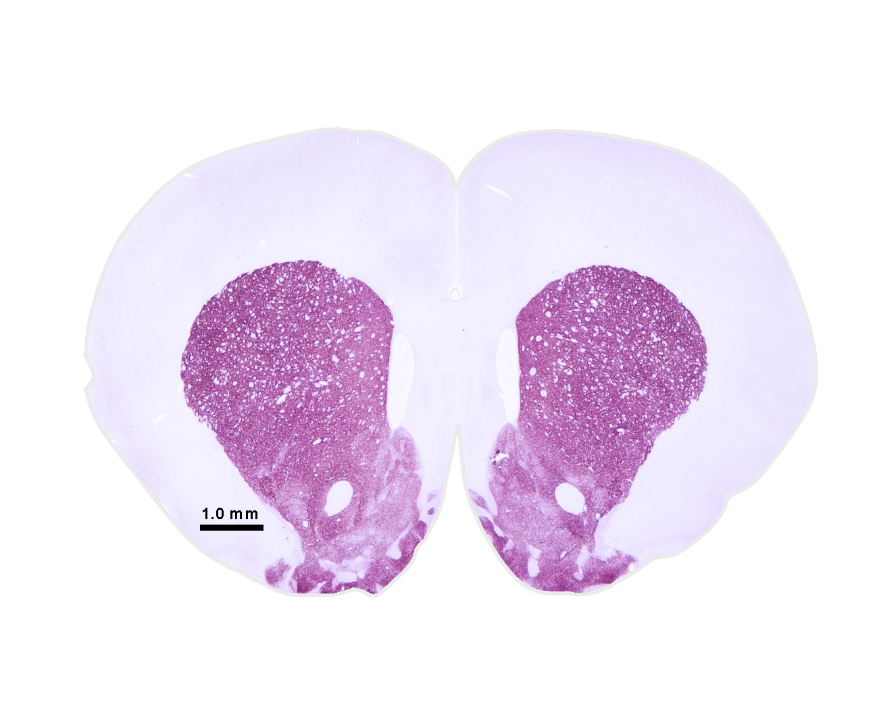
Adenosine Receptors: A1 and A2A subtypes common in brain
High Concentrations of A2A Receptors in the DA-rich areas in neostriatum and nucleus accumbens.
cpu
acc
neostriatum
Adenosine A2A receptor- like immunoreactivity
in rat and human
accumbens
Vontell et al. 2010

Slide 33
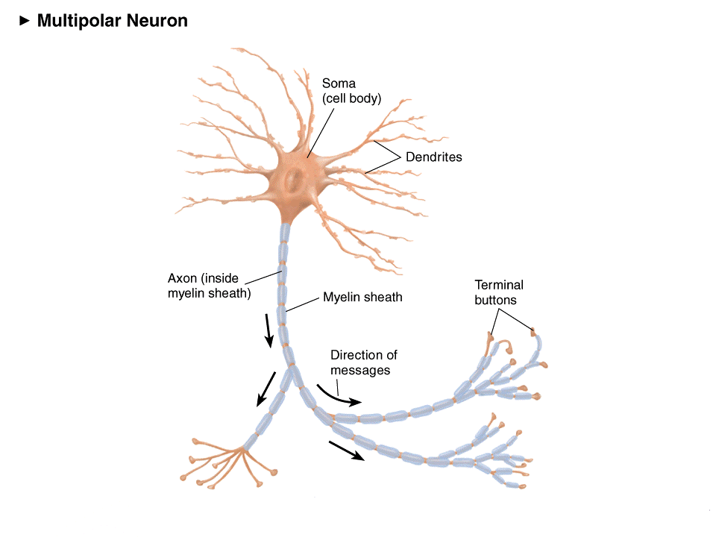
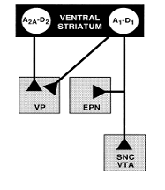
(Adapted from Ferré, 1997)
A2A
Striatum
D2
D2
A2A
Ventral
Pallidum
Adenosine A2A receptors and DA D2 receptors are co-localized on striatal neurons. They exert opposite effects on cAMP related signaling cascades, and can form heteromers.

Slide 34
BEHAVIORAL EFFECTS OF ADENOSINE A_{2A} ANTAGONISTS
Can adenosine A_{2A} antagonists reverse the parkinsonian-like motor impairments produced by D2 antagonists???
- catalepsy
- tremulous jaw movements
Notes:
34

Slide 35
*
*
*
*
KW 6002 and MSX-3
decrease catalepsy in pimozide-treated
rats
*
*
*
*
Salamone et al. 2008

Slide 36
Tremulous Jaw Movements (TJMs)
Definition: RAPID, REPETITIVE, VERTICAL
DEFLECTIONS OF THE LOWER
JAW, WHICH RESEMBLE CHEWING
BUT ARE NOT DIRECTED AT ANY
PARTICULAR STIMULUS
Model of parkinsonian tremor
Produced by DA depletion, DA antagonism & cholinomimetics
Responsive to antiparkinsonian drugs: L-DOPA, apomorphine, bromocriptine, pergolide, ropinirole, Cogentin, Artane
Occur in the 3-7 Hz frequency range

Slide 37
EMG: Tremor in the Temporalis Muscle (jaw)
3.0-7.5 Hzz
1 sec
EMG in
Temporalis Muscle
Ishiwari et al. 2005
1 sec

Slide 38
A2A antagonist KF-17837 decreases oral tremor in haloperidol-treated rats.
*
*
Correa et al. 2004

Slide 39
KW 6002 (Istradefylline) and MSX-3 reduce the oral tremor induced by antipsychotics
*
*
*
*
*
*
*
*
*
*
*
*
Salamone et al., 2008

Slide 40
BEHAVIORAL EFFECTS OF ADENOSINE A_{2A} ANTAGONISTS
Can adenosine A_{2A} antagonists reverse the impairments in novelty-induced activity produced by D2 antagonists???
Notes:
40

Slide 41
A
*
*
*
*
HP
Alone
*
ETIC
Alone
Haloperidol 0.5 mg/kg
Collins et al. 2010
B
MSX-3 increases locomotion in haloperidol- and eticlopride-treated
rats
*
*
*
*
HP
Alone
Haloperidol 0.5 mg/kg
Ishiwari et al. 2007

Slide 42
BEHAVIORAL EFFECTS OF ADENOSINE A_{2A} ANTAGONISTS
Can adenosine A_{2A} antagonists reverse the effort-related motivational effects of DA antagonists???
- operant concurrent choice task
- T-maze barrier choice task
Notes:
42

Slide 43
CONCURRENT LEVER PRESSING/FEEDING TASK
Palatable food /
FR 5
??
Lab chow /
Free access
CONTROL RAT
DA DEPLETED OR DA ANTAGONIST

Slide 44
Interactions Between DA D₂ Antagonist Haloperidol and Adenosine A_{2A} antagonist MSX-3
#
*
*
*
#
MSX-3 attenuates the effort-
related effects of haloperidol
Farrar et al. 2007
Notes:
44

Slide 45
KW6002 (A2A) and Haloperidol (D2)
#
*
*
*
*
*
#
KW6002 attenuates the effort-
related effects of haloperidol
Salamone et al. 2009

Slide 46
A_{2A} vs. D₂ Antagonism
MSX-3 completely reverses the effort-
related effects of eticlopride
Worden et al. 2009

Slide 47
Intra-accumbens co-administration of MSX-3 reversed the effect of intra-accumbens eticlopride on the concurrent choice procedure
# Indicates p < 0.05, ## Indicates p < 0.01, significantly different from Veh/Veh
* Indicates p < 0.05, ** Indicates p < 0.01 significantly different from ETI/Veh
Farrar et al. 2010

Slide 48
T- MAZE
??
Salamone et al. 1994
Cousins et al. 1996
Mott et al. 2009
Correa et al. 2009
Notes:
48

Slide 49
T-maze Task: A_{2A} or A₁ vs. D₂ Antagonism
MSX-3: Adenosine A2A Antagonist
DPCPX: Adenosine A1 Antagonist
*
*
*
#
#
*
MSX-3, but not DPCPX, completely reverses the
effort-related effects of haloperidol
Mott et al. 2009

Slide 50
Mouse T-Maze Studies: Adenosine antagonists vs. haloperidol (D₂)
MSX-3 (A2A)
theophylline
*
*
*
*
*
#
#
CPT (A1)
#
Correa et al. 2009

Slide 51
BEHAVIORAL EFFECTS OF ADENOSINE A_{2A} ANTAGONISTS
Can adenosine A_{2A} antagonists reverse the effort-related motivational effects of DA antagonists???
- operant concurrent choice task
- T-maze barrier choice task
- active maternal behavior
YES!!!!
Notes:
51

Slide 52
Question 3- Can adenosine A_{2A} antagonists dissociate the motivational and antipsychotic effects of D2 antagonists in humans, or do these effects consistently co-vary?
Prediction: Adenosine A_{2A} antagonists will reverse the motor side effects of D2 antagonists in humans, and will reverse the motivational impairments such as apathy, anergia.
What will be the effects of A_{2A} antagonism on the core antipsychotic effect?

Slide 53
Question 4- What will be the effects of A_{2A} antagonism on the core antipsychotic effect of D2 antagonists?
This is an EMPIRICAL QUESTION. Human research in this area is urgently needed!!!
What is known about...
- The role of A_{2A} receptors in processes that are potentially related to schizophrenia?
Caffeine and psychosis in humans?
Effects of A_{2A} antagonists on psychosis in humans?

Slide 54
Question 4- What will be the effects of A_{2A} antagonism on the core antipsychotic effect of D2 antagonists?
Behavioral Effects of A_{2A} agonists
- suppress locomotor activity
- induce catalepsy
- attenuate stimulant-induced behaviors
- impair avoidance behavior
- decrease food-reinforced lever pressing
- local injections into nucleus accumbens alter effort-related choice behavior
Martin et al. 1993; Barraco et al. 1993; Wardas 2008

Slide 55
Question 4- What will be the effects of A_{2A} antagonism on the core antipsychotic effect of D2 antagonists?
Behavioral Effects of A_{2A} agonists
- suppress locomotor activity
- induce catalepsy
- attenuate stimulant-induced behaviors
- impair avoidance behavior
- decrease food-reinforced lever pressing
- local injections into nucleus accumbens alter effort-related choice behavior
But don’t get too excited…D1 antagonists SCH 23390 and ecopipam do all these things as well, and they are not antipsychotic drugs!

Slide 56
Question 4- What will be the effects of A_{2A} antagonism on the core antipsychotic effect of D2 antagonists?
There is a literature on the effects of adenosine agonists and antagonists on prepulse inhibition. However, results are mixed.
Caffeine increased startle amplitude, but did not increase PPI
Theophylline did not affect PPI, but did potentiate apomorphine-induced disruption of PPI
Caffeine and theophylline produce mixed results on PPI in humans
Istradefylline (KW6002) did not affect PPI
MSX-3 injected into accumbens did affect PPI
The A_{2A} agonist CGS21680 reversed the effect of PCP on PPI, but at high doses that also blunted the startle response, and produce sedation
A relatively high dose of CGS21680 reversed the effect of PCP on PPI, but not the effects of apomorphine or amphetamine.
Conclusion- these studies to not provide a valid reason for failing to test question #4 in humans.
Bakshi et al. 1995; Koch and Hauber. 1998; Sills et al. 2001; Weiss et al 2003; Wardas 2003, 2008

Slide 57
Question 4- What will be the effects of A_{2A} antagonism on the core antipsychotic effect of D2 antagonists?
What is known about caffeine and psychosis in humans? Results are mixed (Wardas 2008).
Some individual reports of psychosis associated with caffeine use; but considering the frequency of caffeine use, it is a rare phenomenon
Some reports that caffeine can worsen symptoms of schizophrenia (De Freitas and Schwartz 1979)
Hughs et al. (1989 ) caffeine elimination did not affect schizophrenic symptoms
Switching from caffeinated to decaffeinated beverages had no effects on schizophrenic symptoms (Mayo et al. 1993; Gurpegui et al. 2006; Zaslove et al. 1991)
Also– caffeine is non-selective, so A₁ actions could contribute to any potential psychotomimetic effect of caffeine.

Slide 58
Question 4- What will be the effects of A_{2A} antagonism on the core antipsychotic effect of D2 antagonists?
What is known about effects of A_{2A} antagonists on psychosis in humans?
- Jenner (2005) in normal human volunteers, doses of 20-60 mg Istradefylline did not induce any psychiatric reactions

Slide 59
Question 4- What will be the effects of A_{2A} antagonism on the core antipsychotic effect of D2 antagonists?
What is known about effects of A_{2A} antagonists on psychosis in humans?
LeWitt et al (2008) in PD patients on L-DOPA, co-administration of istradefylline (40 mg), there was no significant effect on hallucinations
Placebo (6.1 %, n= 66) Istradefylline (3.9 %, n = 129)

Slide 60
Question 4- What will be the effects of A_{2A} antagonism on the core antipsychotic effect of D2 antagonists?
This is an EMPIRICAL QUESTION. Human research in this area is urgently needed!!!
Potential Benefits of this Study:
Could identify a useful treatment for the motor and motivational side effects of antipsychotic drugs; might provide some cognitive enhancement.
Could test this important hypothesis about the potential relation between the motivational effects of D2 antagonists and their core antipsychotic effects.

Slide 61
Question 4- What will be the effects of A_{2A} antagonism on the core antipsychotic effect of D2 antagonists?
Potential Benefits of this Study:
If adenosine A_{2A} antagonists do not reverse the antipsychotic effects of D2 antagonists in humans, this will be a vital clue as to their mechanism of action.
It would indicate that the population of D2 receptors being blocked to produce the antipsychotic effect are not co-localized with A_{2A} receptors. This could suggest either an action on D2 receptors in cortex, or on a subgroup of corticostriatal GLU terminals that do not contain A_{2A} receptors.
If adenosine A_{2A} antagonists do reverse the antipsychotic effects of D2 antagonists in humans, this would support the hypothesis of Kapur, and indicate that striatal effects on motivation and motor control are fundamentally related to the antipsychotic actions of D2 antagonists.

Slide 62
THANK YOU!
Notes:
62

