Slide 1
Prenatal/Perinatal Insults as Models of Schizophrenia
Anthony A. Grace, Ph.D.
Departments of Neuroscience,
Psychiatry and Psychology
University of Pittsburgh

Slide 2
Issues in Developing Animal Models of Schizophrenia
- Schizophrenia is a genetically linked disorder with multiple risk factors contributing to its expression
Nonetheless, there are predisposing risk factors that increase the probability of schizophrenia births:
-Influenza infection during the 2nd trimester
-Maternal stress, famine, fetal distress
By introducing risk factors during gestation of sufficient magnitude to disrupt development, some of the deficits observed in schizophrenia may be reproduced

Slide 3
This type of insult-induced pathophysiology consistent with schizophrenia has been observed in animal models with several types of interventions:
-fetal hypoxia
-maternal stress
-gestational x-irradiation
-immune system activation
-MAM
The critical variable does not appear to be the form of the intervention, but seems to be the timing and magnitude of the insult

Slide 4
Timeline:
Knockout
immune, hypoxia
MAM
drug
NVHL
GD17
Birth
PD7-10
Puberty
Adult
GD0

Slide 5
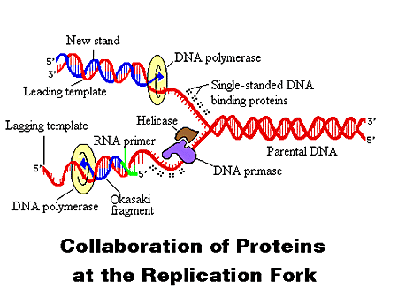
MAM developmental model of schizophrenia: mitotoxin administered to rats at GD 17 and test as adults
Adapted from accessexcellence.org (National Health Museum)
MAM
Possible actions of MAM
on DNA
By interfering with DNA replication, the MAM model may approximate some genetic/developmental etiological variables that are postulated to be present in schizophrenia

Slide 6
MAM developmental model of schizophrenia
1. Anatomical Evidence:
- thinning of limbic cortical structures
- increased cell packing density
2. Behavioral Evidence:
- impairment in prepulse inhibition of startle
- impairment in reversal learning
-impairment in latent inhibition
-impairment in social interaction
3. Pharmacological Evidence:
- increased response to PCP
- increased locomotion to amphetamine in adult
- no difference in response to amphetamine in prepubertal stage

Slide 7
Augmented Response to Amphetamine
In Post-Pubertal MAM-Treated Rats
Saline
800
600
400
200
0
0
5
10
15
20
25
30
35
40
45
50
55
60
Amphetamine 0.5 mg/kg
800
600
400
200
0
0
5
10
15
20
25
30
35
40
45
50
55
60
Amphetamine 1.0 mg/kg
800
600
400
200
0
0
5
10
15
20
25
30
35
40
45
50
55
60
Time (minutes)

Slide 8
MAM developmental model of schizophrenia
1. Anatomical Evidence:
- thinning of limbic cortical structures
- increased cell packing density
2. Behavioral Evidence:
- impairment in prepulse inhibition of startle
- impairment in reversal learning
3. Pharmacological Evidence:
- increased response to PCP
- increased locomotion to amphetamine in adult
- no difference in response to amphetamine in prepubertal stage
The increased dopamine response is consistent with imaging
studies demonstrating heightened striatal DA response
in schizophrenia

Slide 9
Conclusion:
In the MAM model of schizophrenia, there is a hyper-responsivity of the dopamine system similar to that observed in schizophrenia patients.
Dopamine hyper-responsivity is suggested to underlie the psychotic state in schizophrenia
Emerging evidence suggests that hyperactivity in the hippocampus may be related to the psychotic state.
What is the state of the ventral hippocampus in the MAM-treated rat?

Slide 10
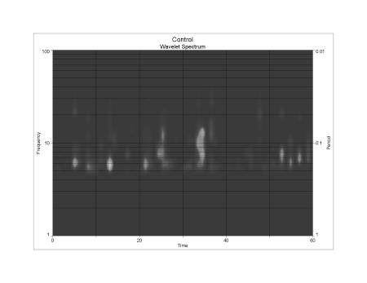
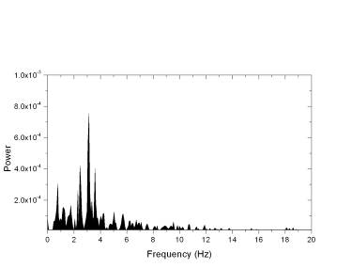
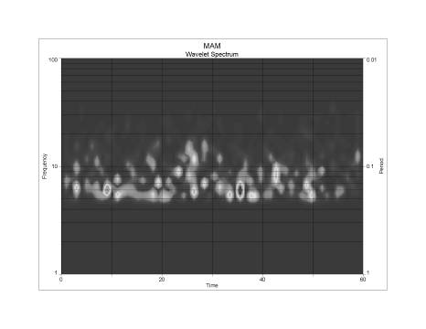
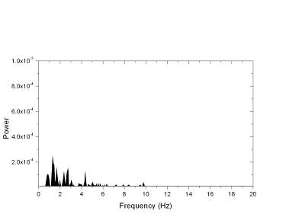
Hippocampal Activity in MAM-treated Rats
1.75
1.50
1.25
1.00
Avg FR (Hz)
0.75
0.50
0.25
0.00
Ctrl
MAM
How does ventral subicular activation afffect VTA DA neuron activity states?

Slide 11
DA Neuron Activity in MAM-treated Rats
2.5
*
10.0
50
2.0
40
7.5
1.5
30
Cells/Track
Avg FR
5.0
Avg % Burst Firing
1.0
20
2.5
0.5
10
0.0
0.0
0
SAL
MAM
SAL
MAM
SAL
MAM

Slide 12
Hippocampal hyperactivity would allow more DA neurons to be available for behavioral activation
“silent” DA neuron inhibited by GABAergic input from VP
Hippocampus
(+)
N. Accumbens
(-)
Ventral Pallidum
(GABA)
VP inactivation

Slide 13
Effects of Hippocampus Inactivation on
DA Neuron Activity
*
2.5
10.0
50
2.0
40
7.5
1.5
30
Cells/Track
Avg FR
Avg % Burst Firing
5.0
1.0
20
0.5
2.5
10
0.0
0.0
0
SAL
MAM
SAL
MAM
SAL
MAM
What is the significance of an increase in DA neuron population activity?

Slide 14
DA Neuron
Firing Pattern
Irregular Firing
10.00
100.00
Burst Firing
10.00
100.00

Slide 15
Regulation of Phasic DA
Neuron Activity
“silent” DA neuron inhibited by GABAergic input from VP
Spontaneously active DA neuron
(disinhibited)
PPTg
(Glutamate)
NMDA only affects depolarized, spontaneously firing DA neurons

Slide 16
“Gain”
“Signal”
Spontaneously active DA neuron
(disinhibited)
“silent” DA neuron inhibited by GABAergic input from VP
Hippocampus
Subiculum
(indirect via Nac-VP)
PPTg
(Glutamate)

Slide 17
Benign Context:
Behaviorally Salient
Stimulus
Pedunculopontine
Tegmentum
DA
Ventral Subiculum

Slide 18
Activating Context:
DA
Behaviorally Salient
Stimulus
Pedunculopontine
Tegmentum
Ventral Subiculum

Slide 19
Schizophrenia:
DA
Salient or Nonsalient
Stimulus
Pedunculopontine
Tegmentum
Ventral Subiculum

Slide 20
Effects of Hippocampal Inactivation on
Amphetamine-Induced Hyperactivity
5000
Ctrl
5000
Ctrl
MAM
MAM (TTx)
4000
4000
3000
3000
Distance Traveled (cm)
Distance Traveled (cm)
2000
2000
1000
1000
0
0
0
10
20
30
40
50
60
70
80
90
0
10
20
30
40
50
60
70
80
90
Time (min)
Time (min)

Slide 21
There are multiple lines of developmental intervention that appear to yield a common pathophysiology that emerges in the adult animal.
Therefore, pathologies introduced early appear to set in motion a set of conditions that lead to alterations in the adult that mimic many aspects of the pathophysiology of schizophrenia in schizophrenia
What types of changes can emerge that lead to hippocampal hyperactivity and may drive these pathological effects?

Slide 22
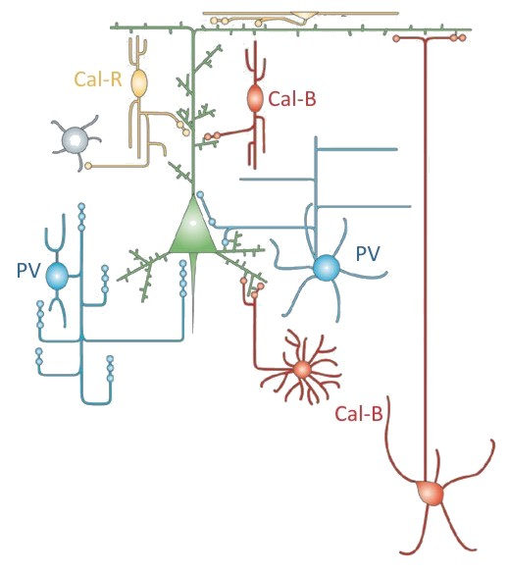
What is the source of increased vSub activity?
Parvalbumin interneurons are selectively decreased in PFC and hippocampus of SZ patients
(Adapted from Lewis et al. Nat Rev Neurosci 2005)

Slide 23
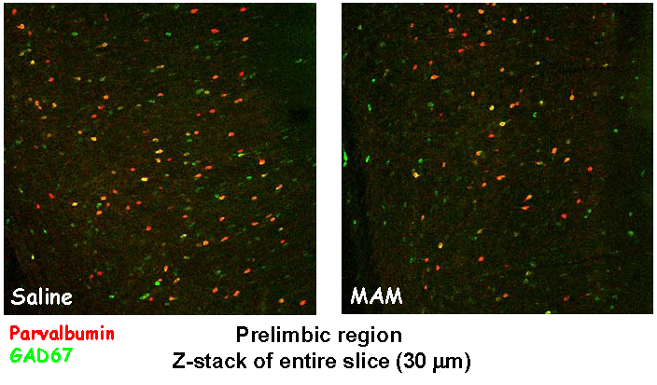
PV - Interneuron Immunohistochemistry
(In collaboration with Dr. Margarita Behrens, UCSD )

Slide 24
PV - Interneuron Cell Counts
4000
Control
MAM
3000
*
*
cells/mm2
2000
1000
MAM rats display a regionally selective reduction in PV interneuron number
0
mPFC
vHipp
No significant differences in dorsal hippocampus
(In collaboration with Dr. Margarita Behrens, UCSD )

Slide 25
How does the decrease in PV interneurons affect information processing?
PV interneurons are known to affect high frequency gamma rhythms that are known to have a role in stimulus recognition and processing
Examine whether activity rhythms evoked by conditioned stimuli are altered in brain regions showing decreased PV interneurons

Slide 26
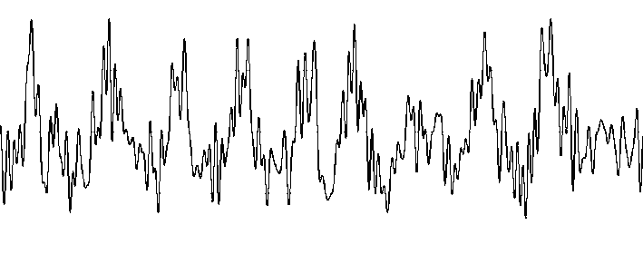
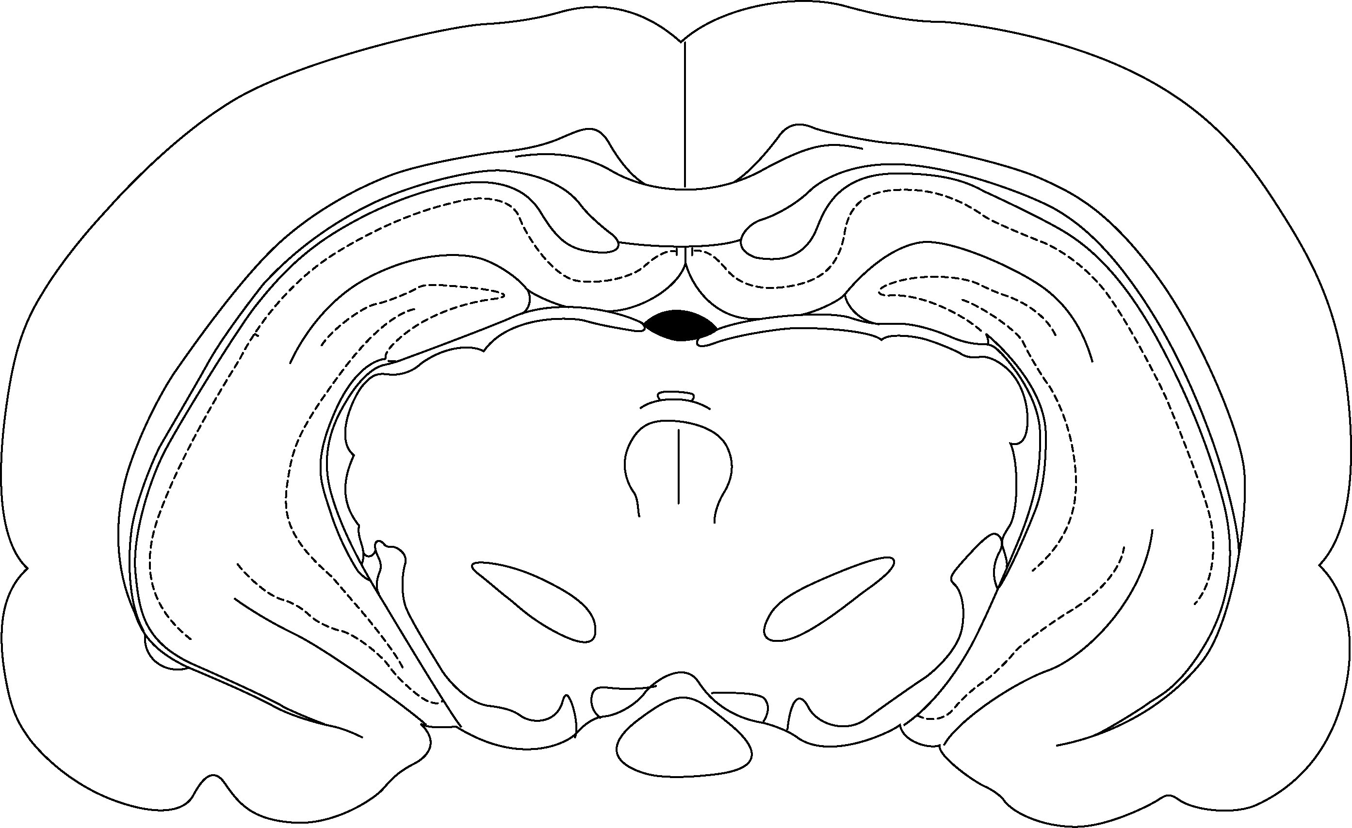
In vivo extracellular field potential recordings
vHipp
mPFC

Slide 27
Gamma band oscillations
mPFC
vHipp
500
300
400
SALINE
300
200
% Baseline
200
100
100
0
0
2
4
6
8
10
0
2
4
6
8
10
Time (sec)
No tone
Conditioned tone

Slide 28
Conclusions:
Evidence suggests that both in schizophrenia and
in the MAM model, there is hyperactivity in the
ventral hippocampus, possibly due to decreased
interneuron function
-This hyperactivity could underlie not only the hyperdopaminergic state, but via interactions with the PFC affect cognitive function and perception
-Inactivation of the ventral hippocampus in the
MAM model restores normal DA system function

Slide 29
In schizophrenia and in the MAM model, interneuron dysfunction can lead to a number of pathophysiological states. Among these is an abnormal hippocampal augmentation of tonic DA neuron activity leading to psychosis
Restoration of interneuron function within hippocampal-prefrontal circuits could be an effective therapeutic strategy in the treatment of
schizophrenia and other disorders

Slide 30
In several developmental animal models in which it has been investigated, a common action on interneurons may underly pathophysiological states.
Interneurons could be a common alteration in a number of disorders, given their late introduction in development and their necessity for regulating rhythmicity and intercortical communication.
What types of common factors present in these developmental models could predispose an animal to interneuron dysfunction and other pathologies that emerge in the adult?

Slide 31
Stress and Psychiatric Disorders:
Stressful stimuli exacerbate the symptoms of
several affective and psychotic disorders
-Stress itself is known to induce glucocorticoid release which,
particularly when combined with additional stress
factors, leads to damage of the hippocampus
(Meaney, Sapolsky McEwen); a region which shows
pathological changes in schizophrenia

Slide 32
Premise:
In normal individuals, the prefrontal cortex limits the effects of stress exposure, in part via actions within the amygdala
In disorders in which prefrontal cortical deficits have a predisposing role, prefrontal cortical deficits may initiate a cascade of events that lead to schizophrenia in adults

Slide 33
Normal:
Mesocortical DA
STRESS
DA modulation of PFC
Feedback Inhibition of
Stress Response

Slide 34
Stress-induced Hippocampal Pathology:
PFC modulation of amygdala
Locus coereleus responsiveness
Regulation of DA Input
STRESS
Hypothalamic and glucocorticoid response to stress
DA modulation of PFC
Hippocampal damage
Phasic DA in accumbens
Hippocampal suppression of stress response
Tonic DA in accumbens
Deficits in PFC function can predispose an individual to stress-induced damage of the hippocampus, leading to permanent alterations in the regulation of responses in stress-related circuits throughout the brain

Slide 35
Advantages/Shortcomings of Developmental Models
Developmental models do not presuppose a specific pathological condition, but instead attempt to mimic risk factors that can lead to psychosis
This approach can be quite useful in finding out what types of systems are sensitive to disruption, which can parallel the alterations found in schizophrenia and lead to new insights into its pathophysiology
This approach depends on cross-validation with human imaging/postmortem studies to evaluate how effectively the condition is reproduced
-Cross-validation is essential to ensure that the model is consistent with the disease state; otherwise one could generate false assumptions regarding pathophysiology
A potential advantage of using accurate risk factor modeling of psychosis could be in the development of measures to circumvent transition to psychosis in susceptible individuals

Slide 36
Advantages/Shortcomings of Developmental Models
One thing that a developmental disruption model does not do is test specific pathophysiological hypotheses, such as selective gene mutations, cell migration alterations, or growth factors that may reproduce a highly specific pathological state
Nonetheless, by uncovering what pathophysiological conditions can be generated by developmental disruptions, a more effective means for identifying the critical variables could facilitate development of the more precise models
e.g., a deficit in parvalbumin interneuron function found in developmental disruption models can serve as the basis for knocking out NMDA receptors selectively on parvalbumin interneurons, which was found to recapitulate some of the hyperdopaminergic states

Slide 37
Developmental models may have an advantage for informing us regarding treatment
Developmental models are restricted in that they do not affect specific systems, but ideally alter the brain in a manner that may be present in schizophrenia
-i.e., just as in schizophrenia, one has to go “poking around” to find out what is changed, and whether that change is directly relevant to schizophrenia or is an epiphenomenon
On the other hand, drugs that are found to be effective in developmental models may have a higher potential to be active in schizophrenia patients depending on the validity of the construct
With respect to the MAM model, this system has informed us regarding the rapid onset of action of dopaminergic antipsychotic drugs, in addition to providing insight into possibly more effective sites of manipulation upstream from the DA dysfunction
These data also provide a potential caution with respect to testing drugs as adjunctive versus primary treatment – interference by common actions on different parts of the same system (e.g., decreasing DA function at two sites)

Slide 38
Acknowledgements
Ali Charara Witek Lipski
Pauline Belujon Michael Mana
Pierangelo Cifelli Holly Moore
Cynthia Correll Eric Nisenbaum
Stan Floresco Patricio O’Donnell
Krysta Fox Shao-Pii Onn
Mehdi Ghajarnia Vince McGinty
Kathryn Gill Michele Pucak
Yukiori Goto Meera Ramsooksing
David Harden Heather Rose
Jeffrey Hollerman J. Amiel Rosenkranz
Hank Jedema Ian Smith
David Jentsch Judy Thompson
Antonieta Lavin Chris Todd
Steve Laviolette Ornella Valenti
Dan Lodge Anthony West
Margarita Behrens, UCSD
James Cook, UWM

